Slide 1

Final Project: Predicting Online News Popularity with Machine Learning
Group Members: Yiwei Li, Hongyu Liao, Han Zhang, Evelyn Zhou, Anqi Gu
Date: March 10, 2025

Slide 2

Introduction
Data Collection & Data Sources
Data Preprocessing & Exploratory Data Analysis (EDA)
Feature Engineering
Modeling & Model Optimization
Evaluation & Model Interpretation
Conclusion & Future Work
Q&A Session

Slide 3
Introduction
Online News Popularity Analysis: Predicting Engagement Drivers
Background：
Digital era: Rapid increase in online news consumption
Reshaping media landscape & competitive digital space
Successful publishers need content that resonates deeply
Research Objective：
Explore dynamics of news popularity by analyzing characteristics & factors across news types
Methodology：
Categorizing "shares" into low/medium/high engagement levels
Applying machine learning techniques:
Random Forest
XGBoost
LightGBM
Feedforward Neural Networks (FNN)

Slide 4
Literature Review
Key Findings from Prior Research
Machine Learning for News Popularity:
Tsai & Wu (2022): XGBoost, LightGBM, SVM; Feature selection improves prediction
Social Influence & Virality:
Rajagopal et al. (2022): Readability, sentiment & psycholinguistic factors impact shareability.
Waddell (2018): Reader comments & engagement metrics affect credibility.
Practical Implications:
Zhang & Lin (2021): Random Forest + PCA enhances efficiency.
Fernandes et al. (2015): IDSS system optimizes articles before publishing.
Notes:
Takeway:
Combining text, images, sentiment, and social dynamics improves article virality prediction.

Slide 5
Data Sources
Source:
UCI Machine Learning Repository (Online News Popularity)
（https://archive.ics.uci.edu/dataset/332/online+news+popularity）
Content:
Metadata and social feedback from 39,797 articles published on Mashable
Structure:
61 attributes
58 predictive features
2 non-predictive fields
1 target variable (shares)

Slide 6
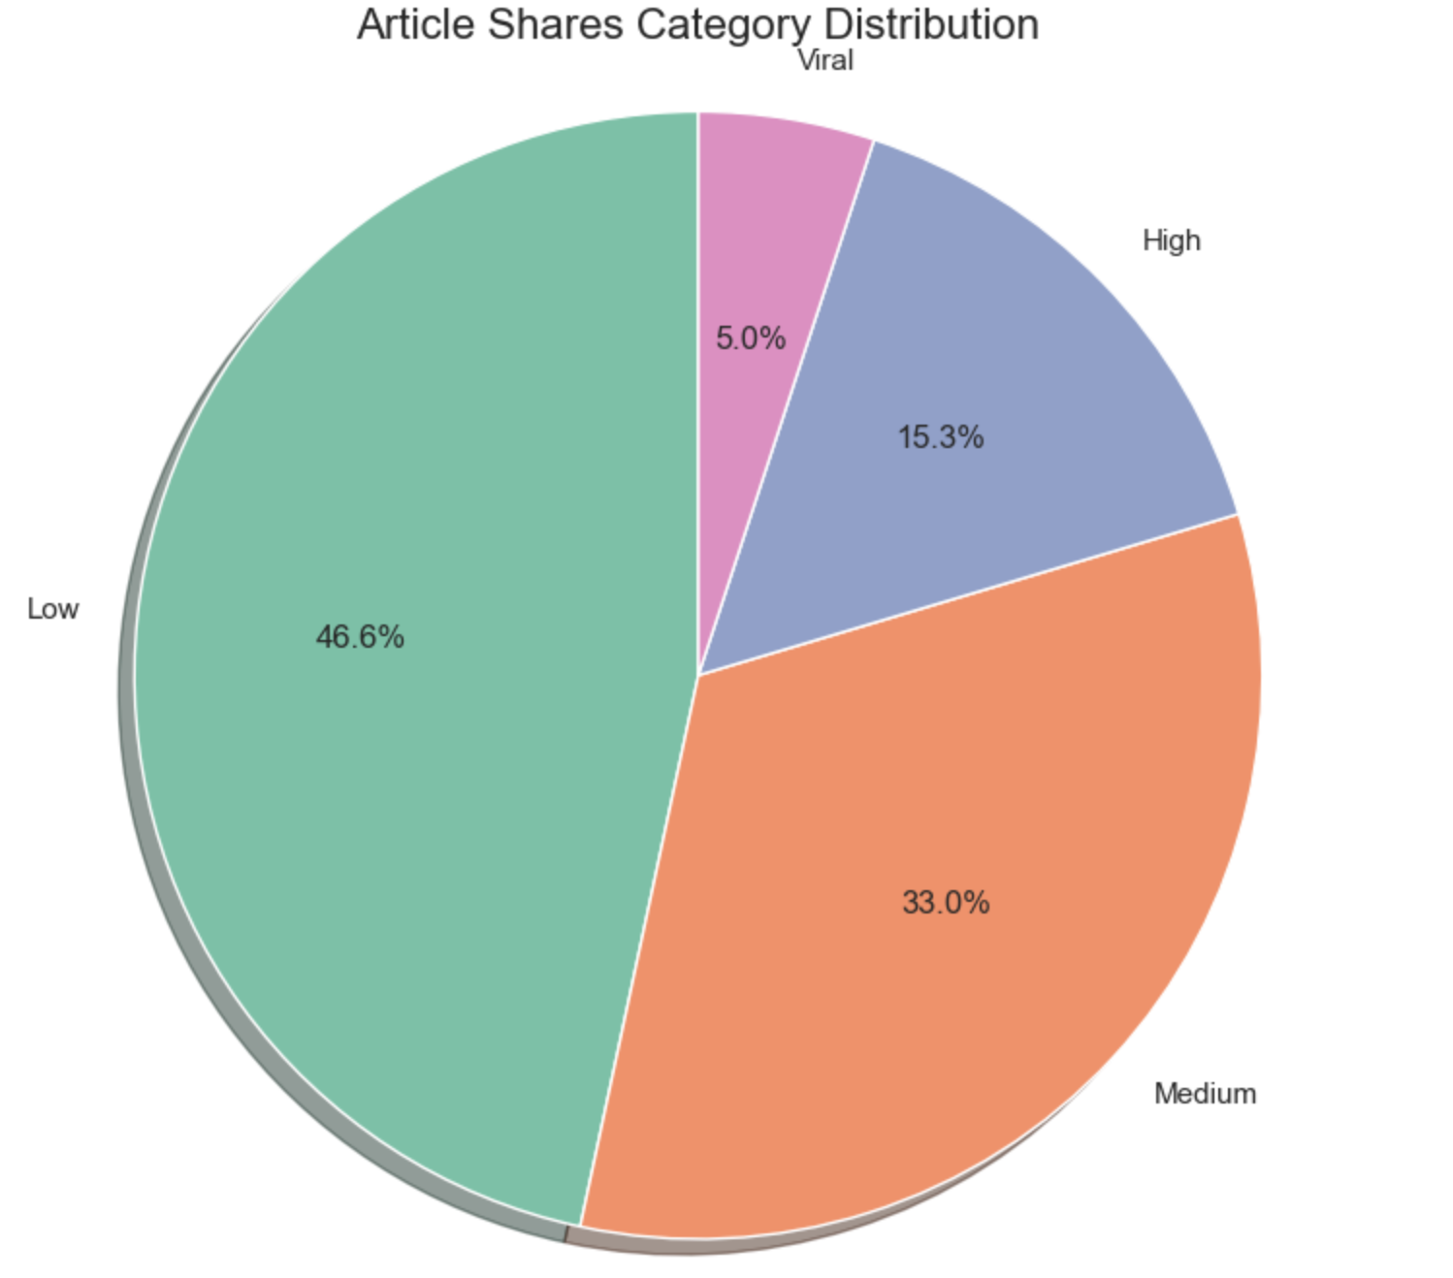
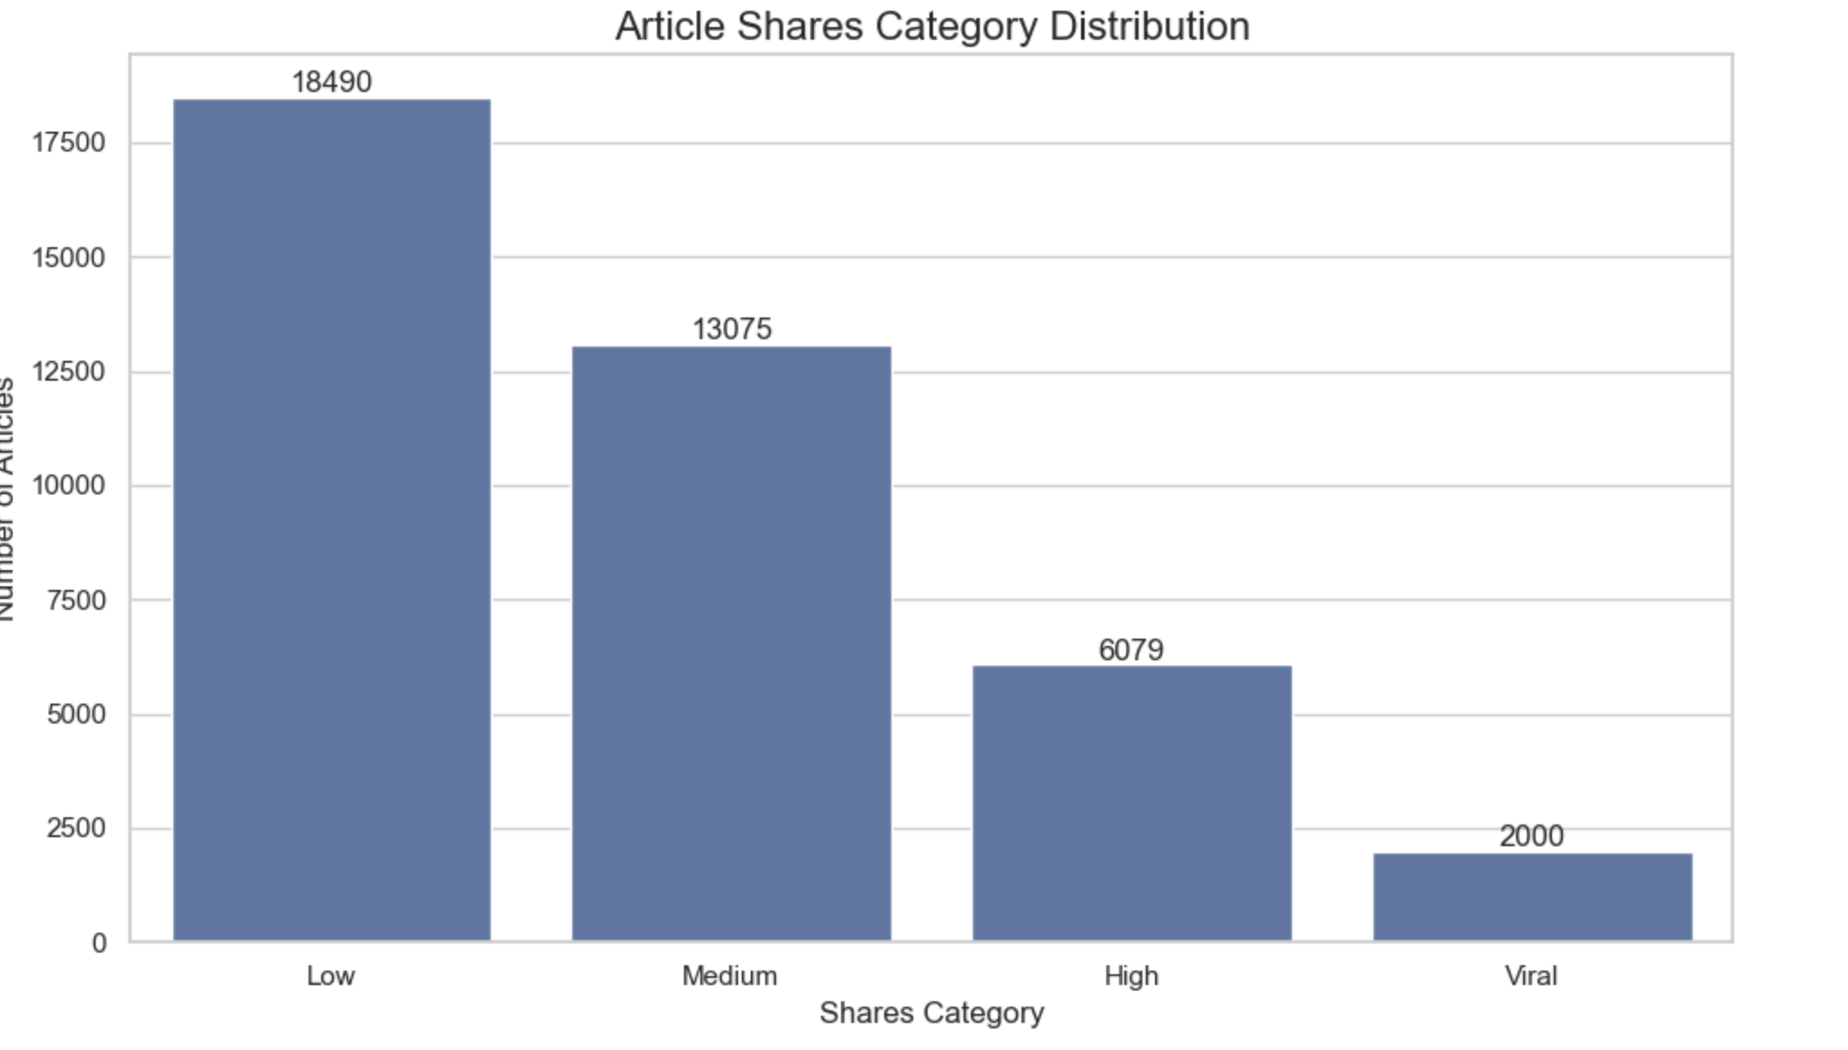
EDA - Overall Article Engagement Distribution
Shares category distribution:
shares
Low: 18490
Medium: 13075
High: 6079
Viral: 2000
Percentage distribution:
shares
Low: 46.64
Medium: 32.98
High: 15.33
Viral: 5.04
Notes:
Interpretation of the Pie Chart: The pie chart shows the proportion of articles in each category. It confirms that 76.6% of articles fall into the Low and Medium engagement levels. It highlights that achieving high or viral status is really rare. The sharp decline in articles with higher engagement suggests that only a select few pieces resonate widely with audiences. So understanding the factors that drive virality is important.
Interpretation of the Bar Chart: The bar chart displays the distribution of articles across different share categories. The majority of articles fall into the Low (18,490 articles, ~46.6%) and Medium (13,075 articles, ~33%) categories, while fewer articles are classified as High (6,079 articles, ~15.3%) or Viral (2,000 articles, ~5%). This indicates that most articles struggle to gain high engagement. Only a small fraction achieving viral success.

Slide 7
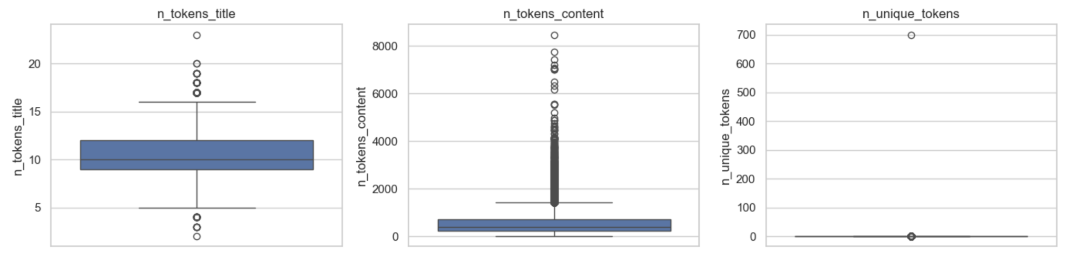
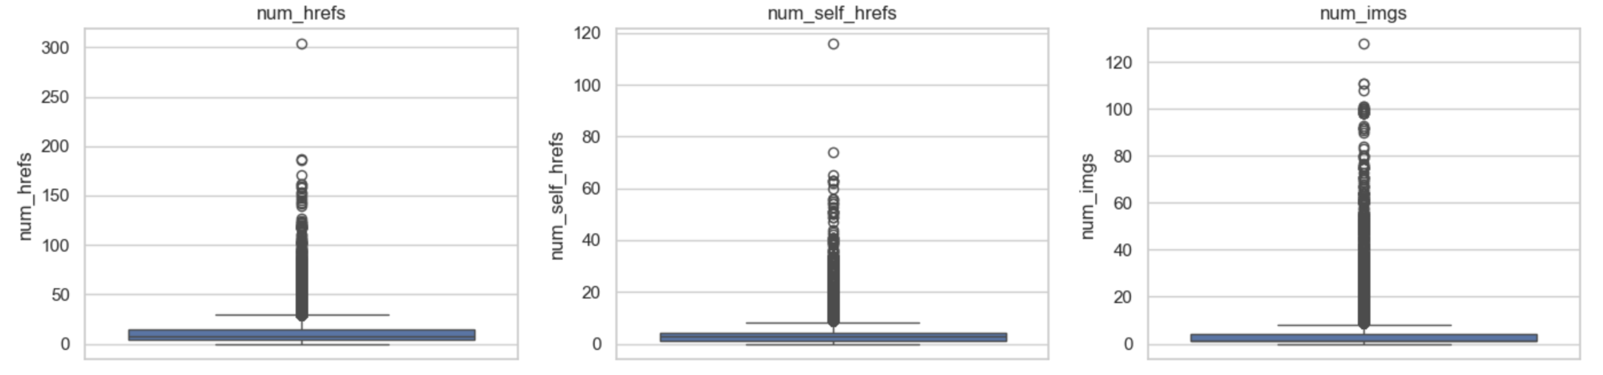
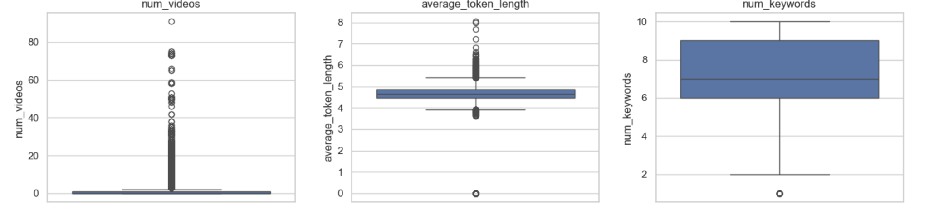
EDA - Article Content Feature Distributions
Overview:
Boxplots showing distribution of article content features
Significant outliers across most variables
Key Findings:
Title length (n_tokens_title): Consistent distribution
Content length (n_tokens_content): Extreme outliers, highly variable
References, images, videos: Heavy-tailed distributions
Keywords: More balanced, typically 6-9 per article
Conclusion:
Highly skewed dataset with many outliers
Next Steps: Apply normalization techniques before predictive modeling

Slide 8
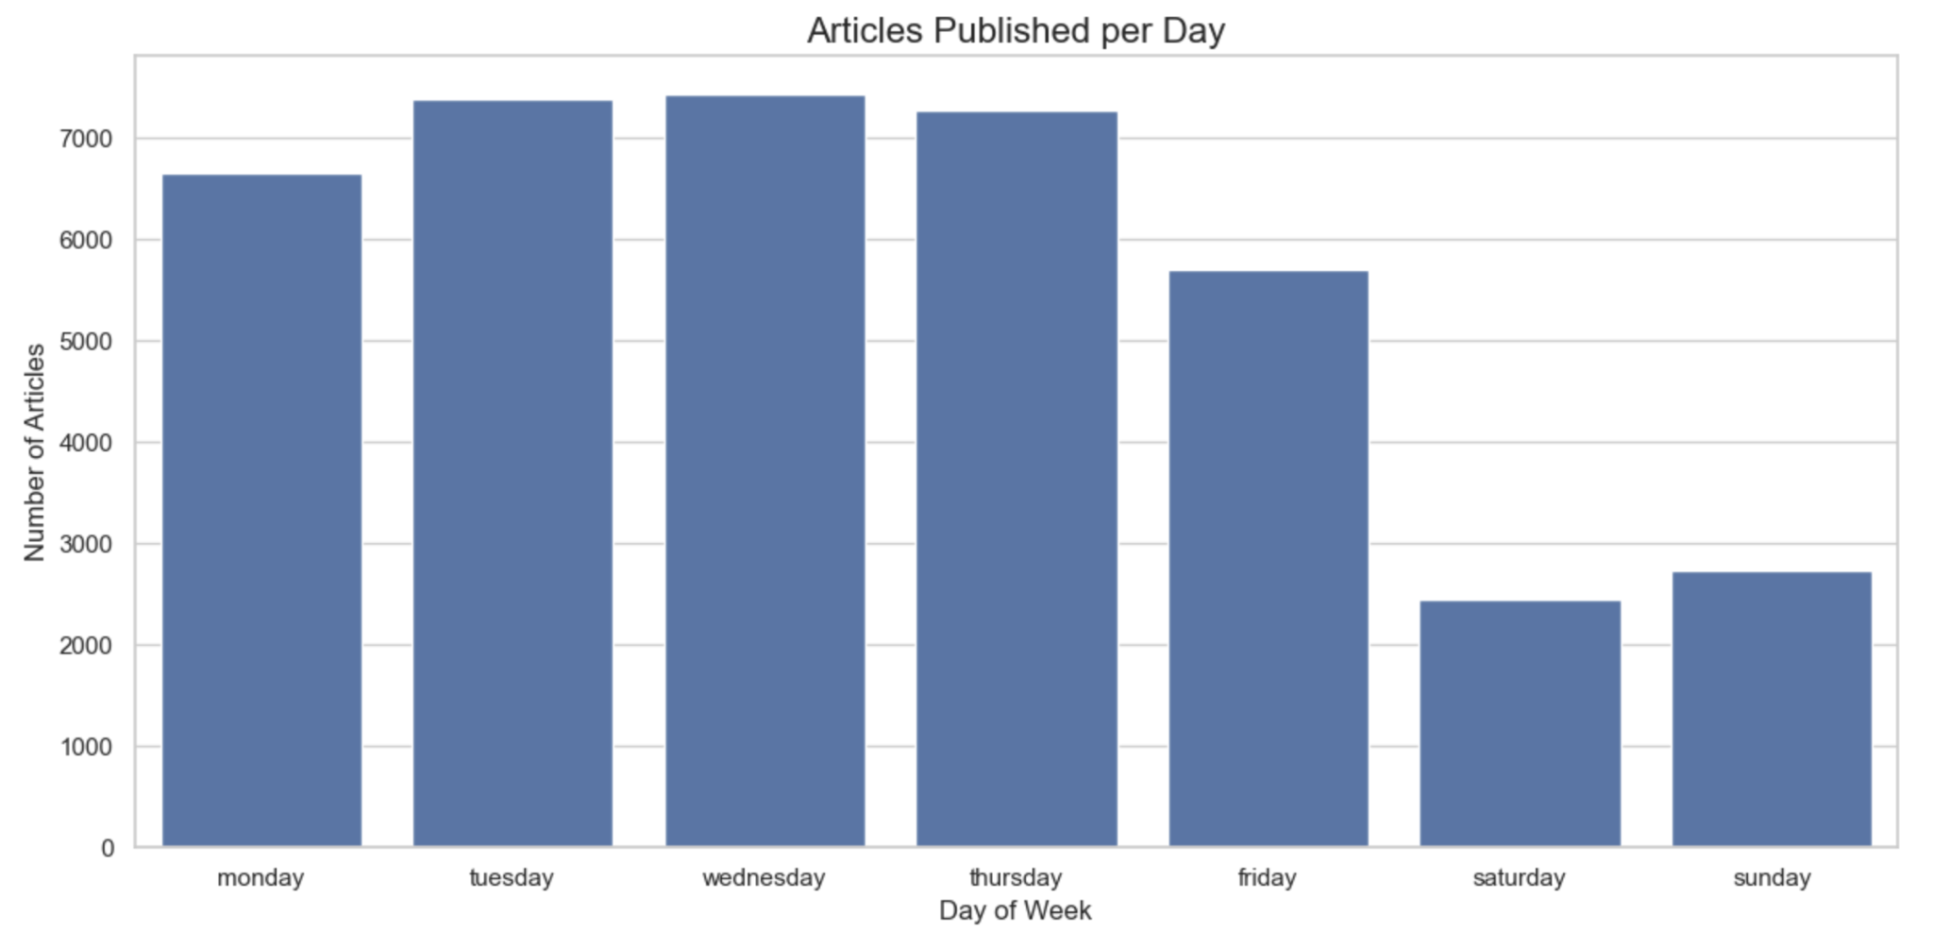
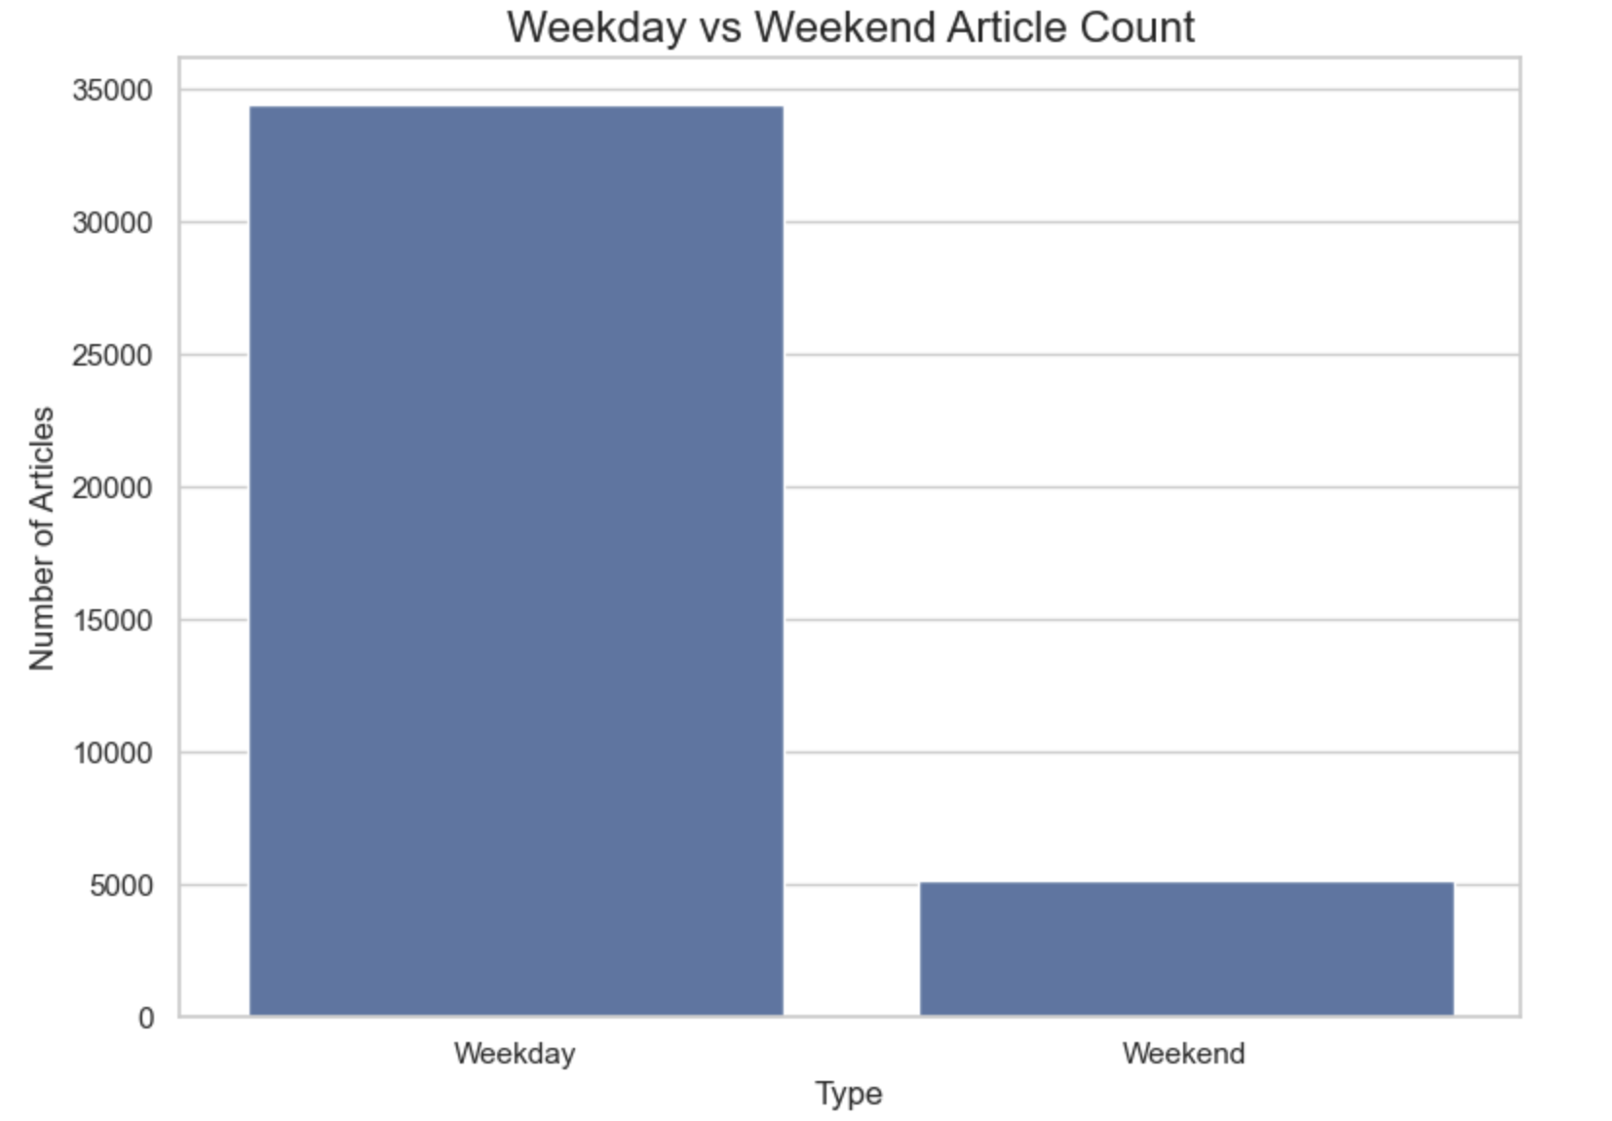
EDA - Content Publication Timing Patterns
Key Insights:
Mid-week peak: Tuesday-Wednesday show highest publication volume
Dramatic weekend drop: 75% fewer articles on weekends vs weekdays
Gradual decline: Publication volume decreases from mid-week
Strategic Implication: Publish strategic content mid-week for maximum visibility
Notes:
Starting with the Article Channel Distribution (Top-left and Bottom-left charts), we can see that the ‘World’ channel has the highest number of articles, followed by ‘Tech’ and ‘Environmental’ categories. In contrast, ‘Second’ and ‘Lifestyle’ have significantly fewer articles. This suggests that certain topics receive much more coverage than others, which may influence reader engagement and traffic.
Next, looking at the Articles Published per Day (Top-right chart), we observe that publication frequency is highest from Monday to Thursday, with a peak on Tuesday and Wednesday. However, starting from Friday, the number of articles drops sharply, reaching its lowest on Saturday. This indicates a clear trend where content production is primarily focused on weekdays, possibly due to newsroom workflows or audience activity patterns.
The Weekday vs. Weekend Article Count (Bottom-right chart) further reinforces this observation. A vast majority of articles are published on weekdays, while the weekend has significantly fewer articles. This could have implications for optimizing content strategies—perhaps tailoring weekend articles differently or adjusting publication schedules for maximum engagement.
In summary, our analysis reveals that article distribution varies widely across channels, and publication frequency follows a strong weekday-heavy trend. Understanding these patterns can help in designing more effective content strategies.

Slide 9
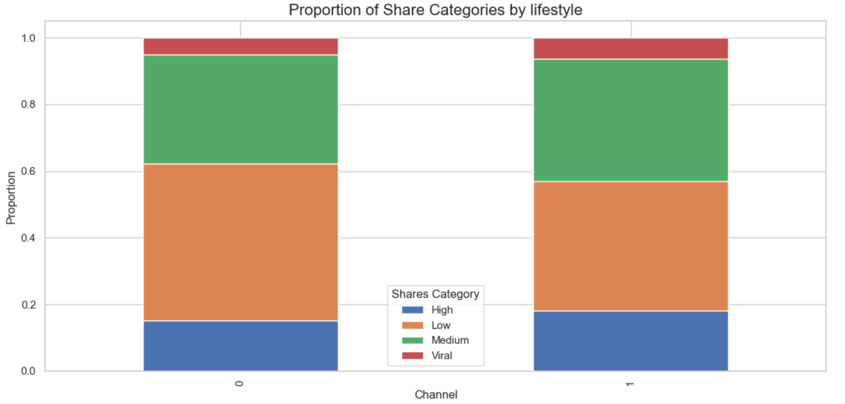
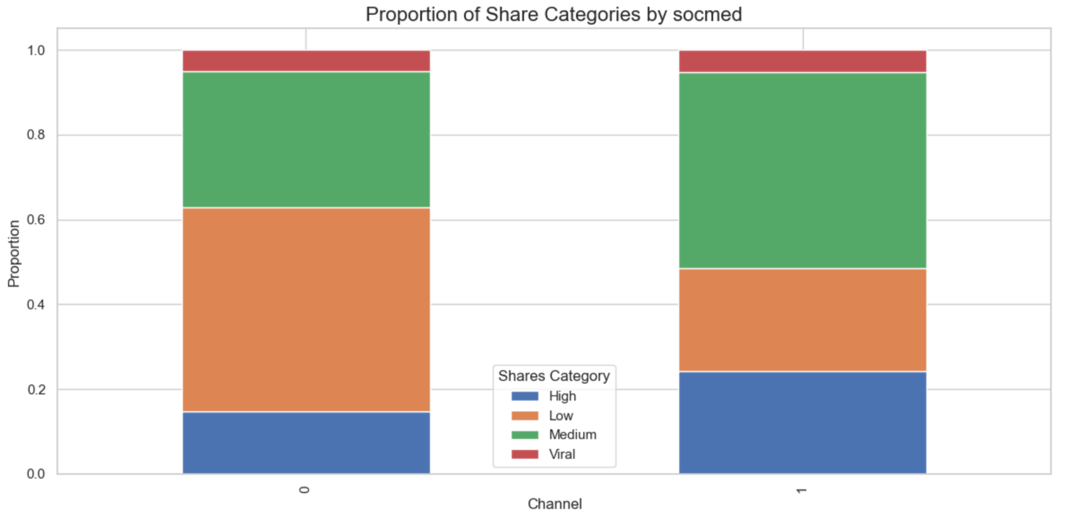
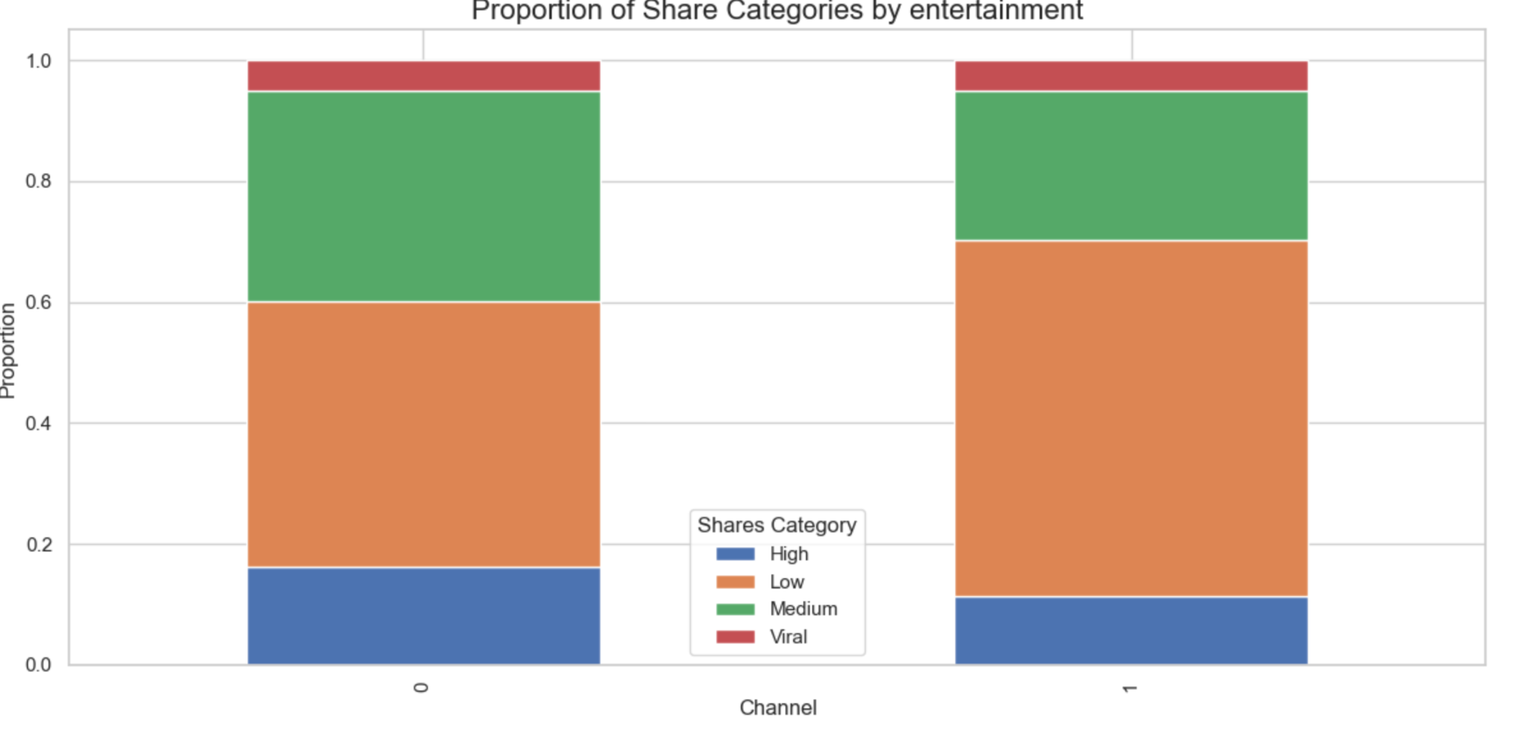
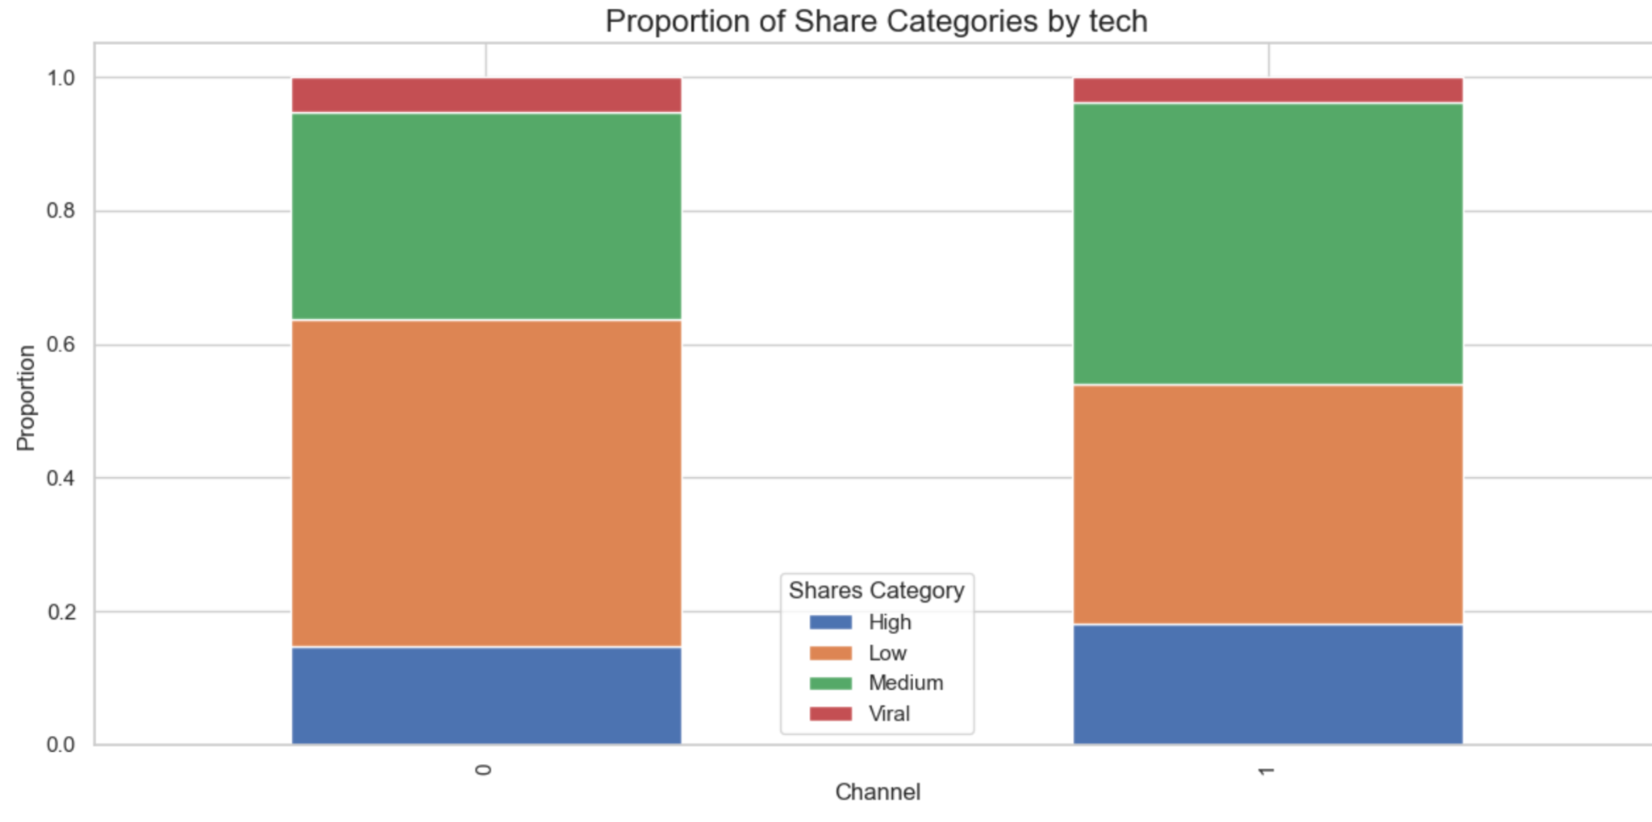
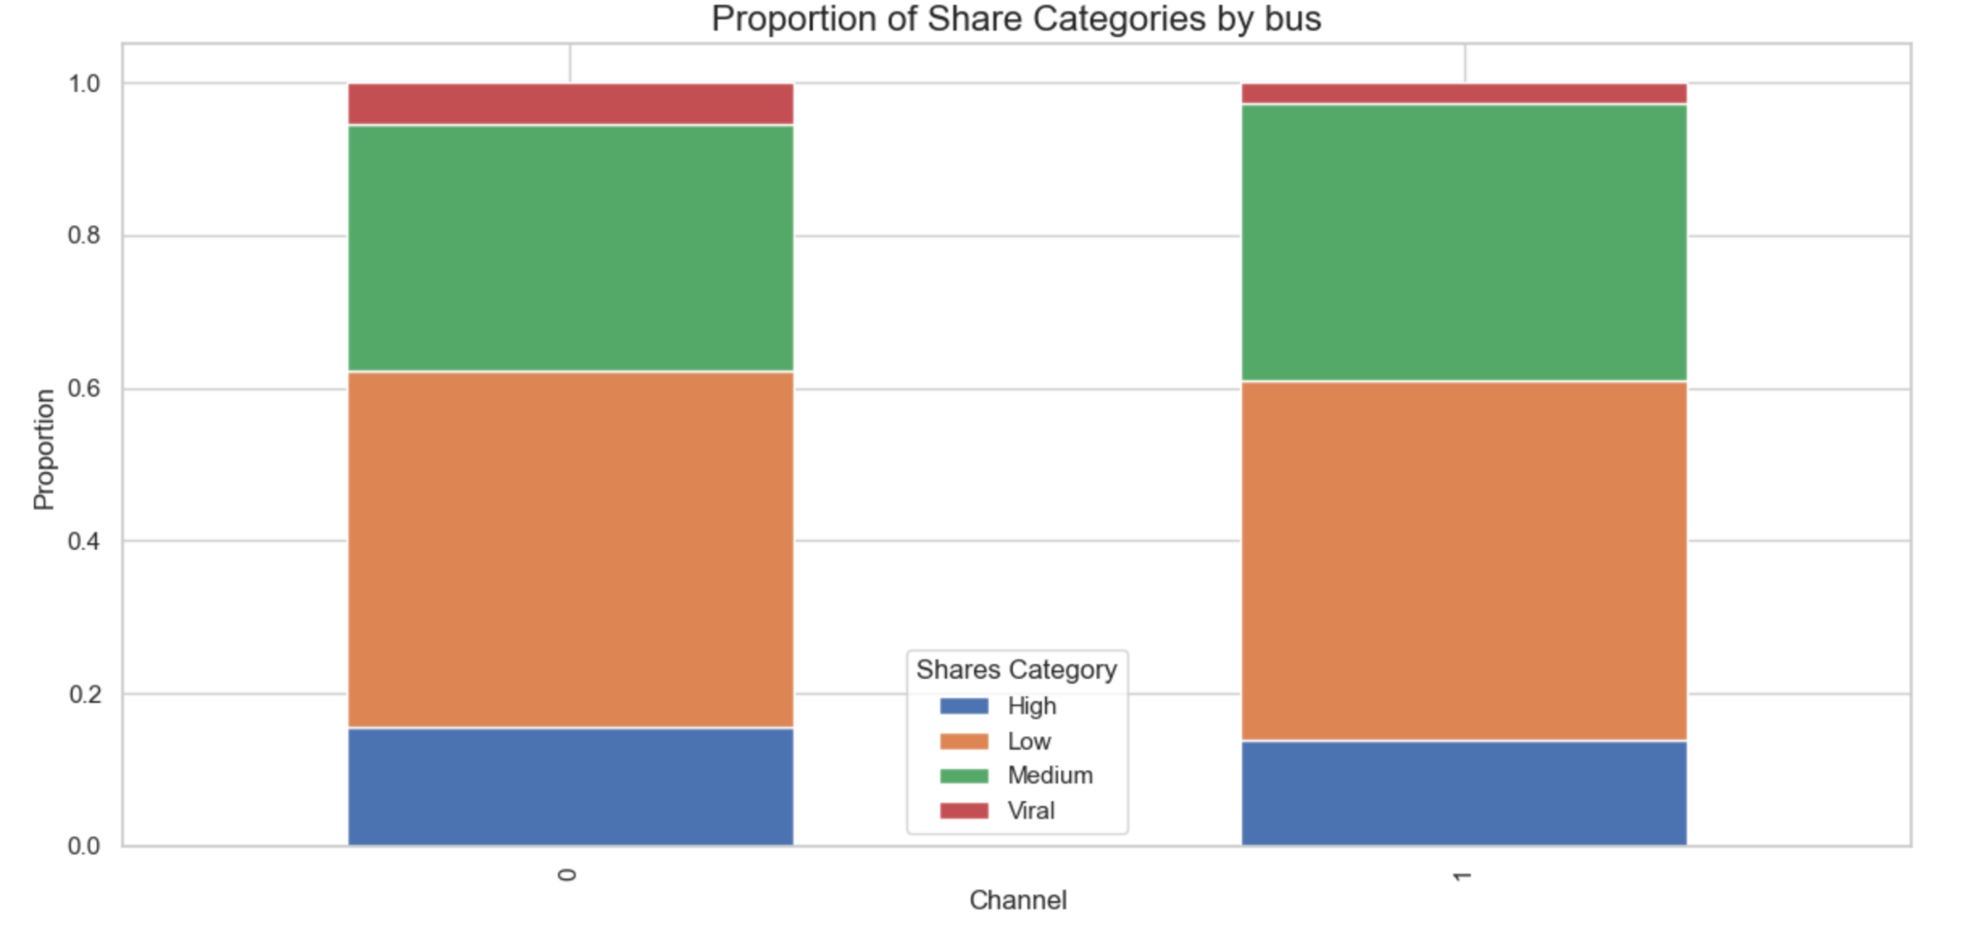
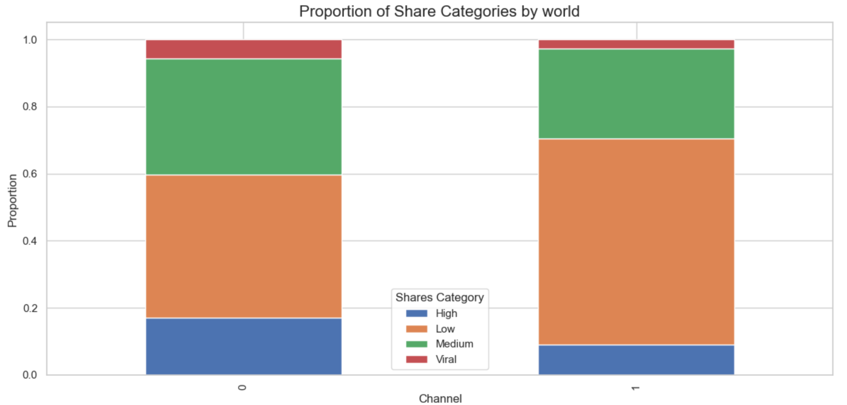
EDA - Share Distribution Across Content Channels
Overview:
Stacked bar charts showing article share categories (Low, Medium, High, Viral) across content channels
Key Insights:
Social media content shows highest High share percentage (24%)
Social media content has strongest Medium share performance (46%)
Low shares dominate across all channels
Viral content consistently represents smallest proportion (<10%)
Recommendation: Focus on social media and tech channels for higher engagement potential.

Slide 10
Is the data set sufficient for the task?
Notes:
Let’s start with a key question: Is this dataset sufficient to complete our task? Or more specifically, can it accurately predict the true value of article shares?
The answer, of course, is no. While the dataset includes features such as the length of the article, number of keywords, and whether it contains images or videos, it fails to capture the actual content of the article. In other word ,It focuses more on the only physical structure of the news rather than the quality of its content.

Slide 11


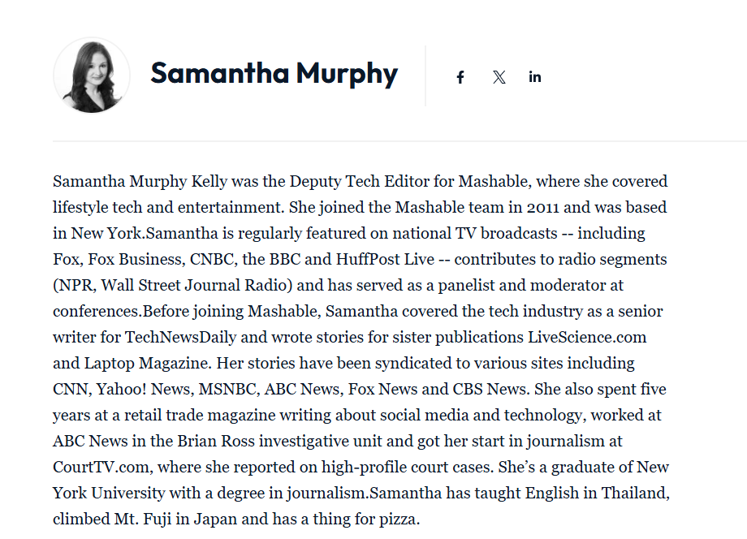
Data Collection — Scrape data: Author & number of followers
Notes:
In addition, since the dataset was collected a long time ago, we could no longer determine the timeliness of each article and the trend in the number of shares. Therefore, we decided to crawl the authors and their social media follower counts. We believe that these features have the potential to reflect the writing style and popularity of the articles, which can help improve the accuracy of the predictions.
To do this, by using the article's URL, we can quickly find the article's page and then visit the author's personal page. Most authors have social media links on their personal pages, which allows us to collect their follower count.

Slide 12
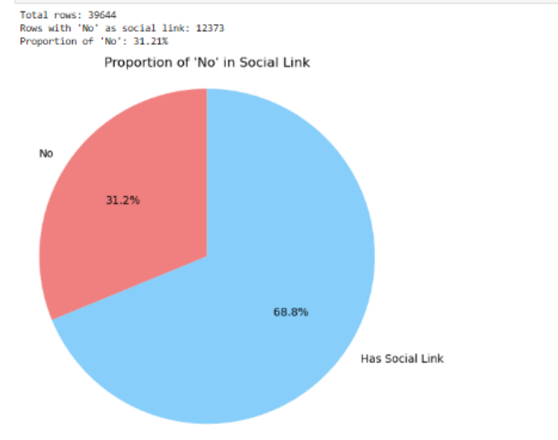
Data Preprocessing — Followers
How do these missing values appear？
Notes:
Next, we need to preprocess the data obtained through the scraping. Since we are using Python scripts, occasionally there are unexpected problems that can lead to missing data.
To handle this effectively, we first investigated the root causes of the missing values

Slide 13
Data Preprocessing—Followers
No author
News by mashable official
Recorded as ”official“
Why is there missing?
News reproduced from other media or organizations
Recorded as “Reprinted”
No social media page
Author is no longer active
Recorded as “Unknown”

Slide 14
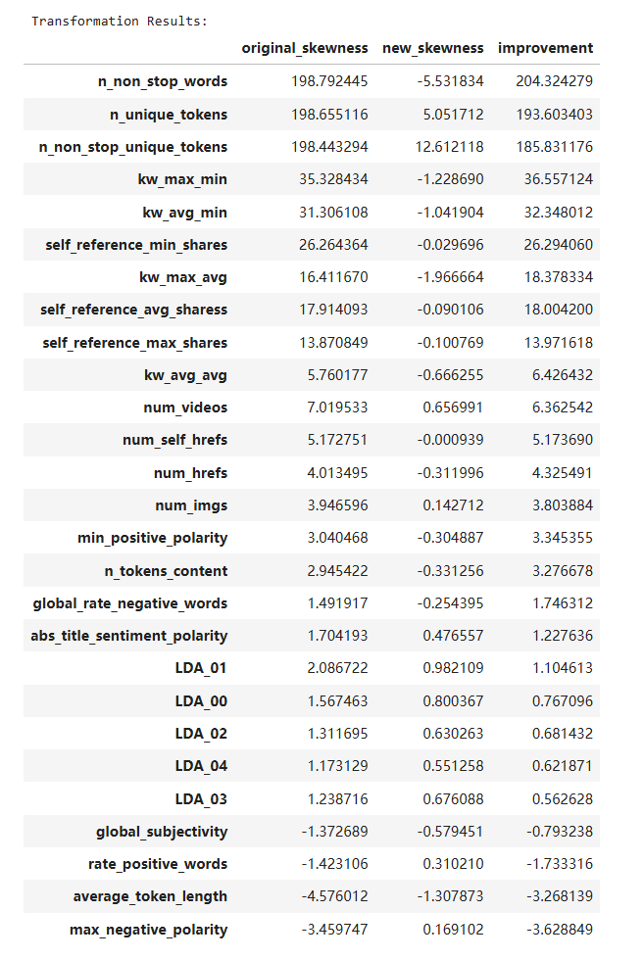
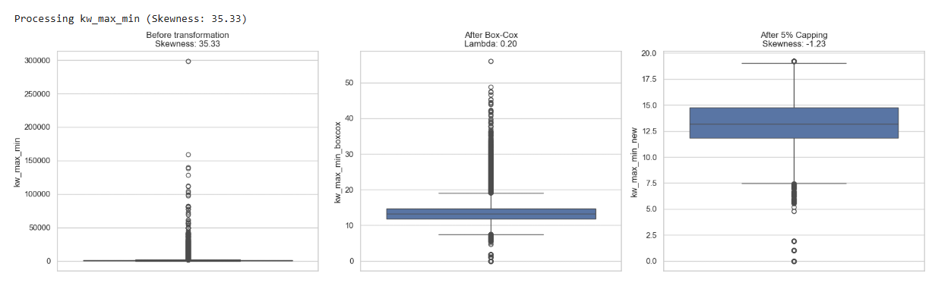
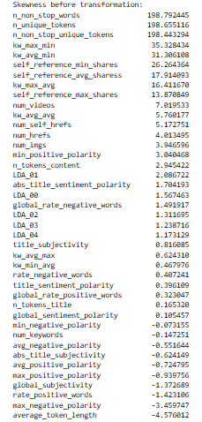
Feature Engineering—Severe data skew
In Use a flexible transformation (Box-Cox) to flatten the distribution and preserve key data characteristics.
Cap remaining extreme values to further reduce skewness and outlier impact, enhancing model robustness.

Slide 15
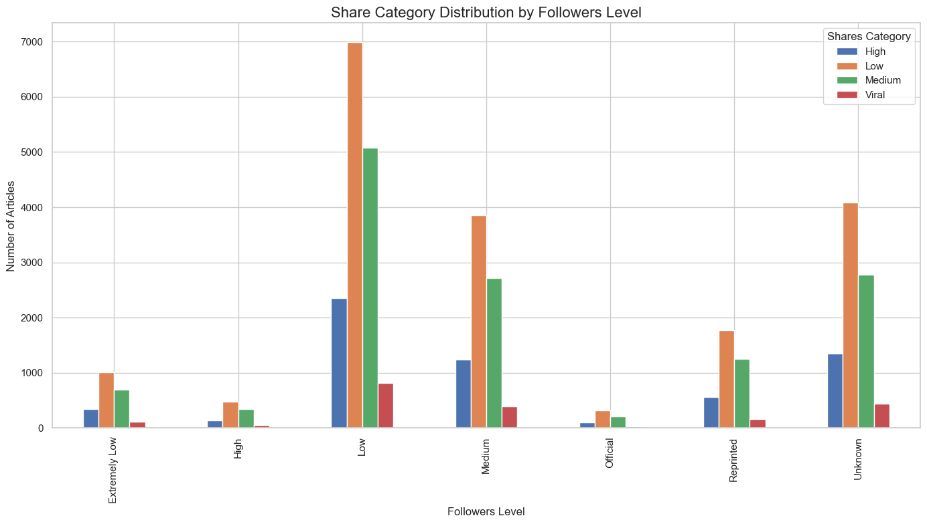
EDA - Content Engagement by Follower Level
Overview:
Bar chart showing content engagement across different follower levels
Four share categories: Low, Medium, High, and Viral
Key Insights:
Low shares dominate across all follower categories
Low and Unknown sources show similar distribution patterns
High follower accounts create minimal content despite their influencer status.
Recommendation: Partner with Low-level creators - they produce highest content volume and generate most viral articles in absolute numbers, maximizing breakthrough potential.

Slide 16
Modeling & Evaluation
Models
Methods
Logistic Regression （OvR）
Random Forest
Gradient Boosting
XGBoost
LightGBM
SMOTE (Synthetic
Minority Over-sampling Technique)
Stacking
PCA

Slide 17
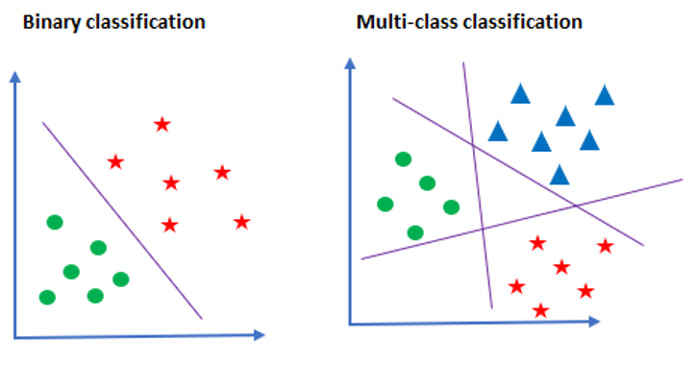
Modeling & Evaluation
Logistic Regression
One vs Rest (OvR)
https://michael-fuchs-python.netlify.app/2019/11/13/ovo-and-ovr-classifier/

Slide 18
Modeling & Evaluation
Random Forest
Bagging-based
Combination of Decision trees
Parallel training
Gradient Boosting
Boosting-based
Gradient descent
Serial training
XGboost
Regularization
Parallelized tree building
High performance
LightGBM
Histogram-based learning
Leaf-wise tree growth
Fast training

Slide 19
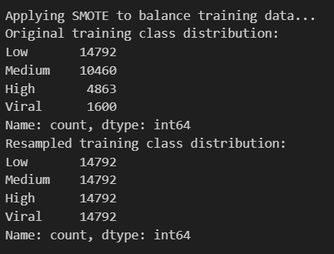
Modeling & Evaluation
SMOTE：Synthetic Minority Over-Sampling Technique
Essentially a KNN model
Powerful tool for imbalanced data

Slide 20
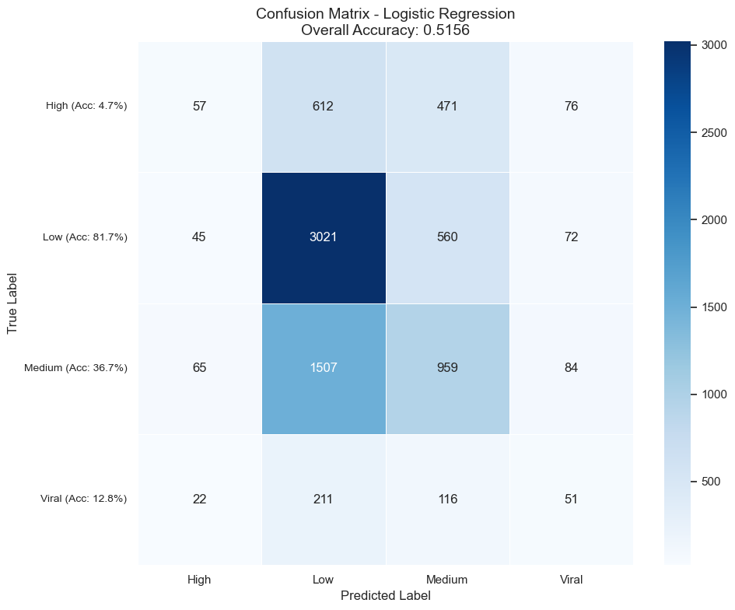
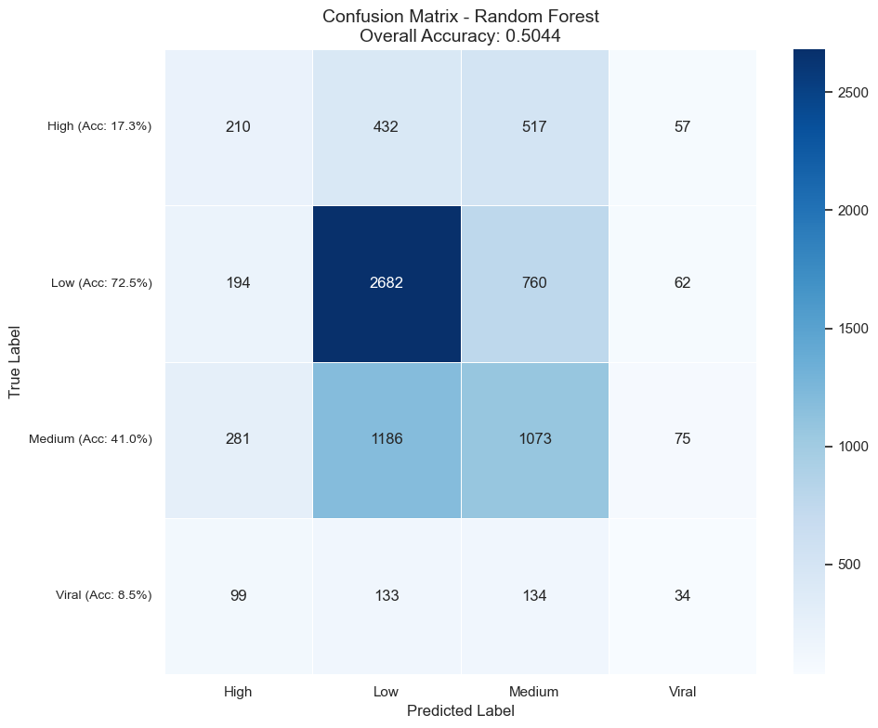




Modeling & Evaluation

Slide 21
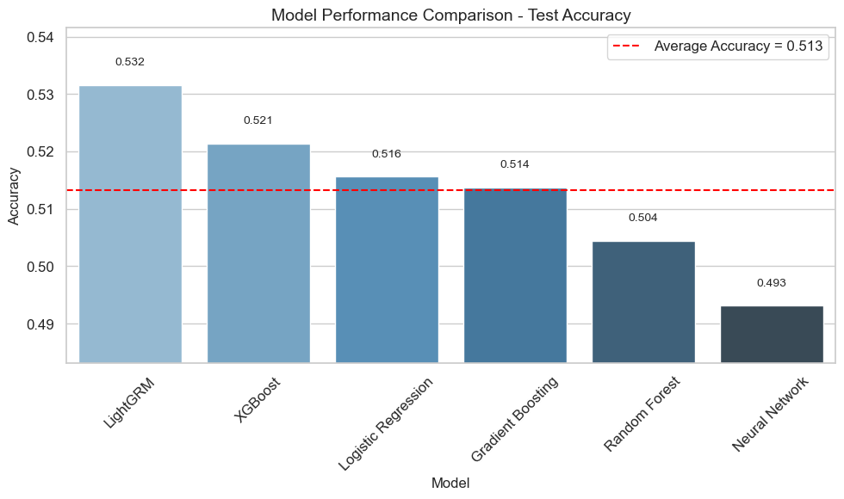
Modeling & Evaluation

Slide 22
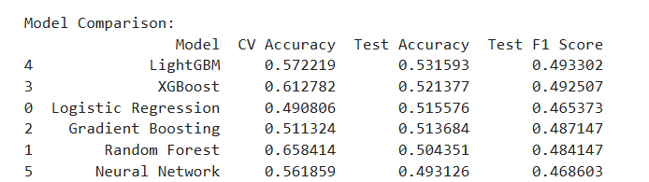
Findings:
Bad Performance
Overfitted (except for LR)
Best Model: LightGBM

Slide 23
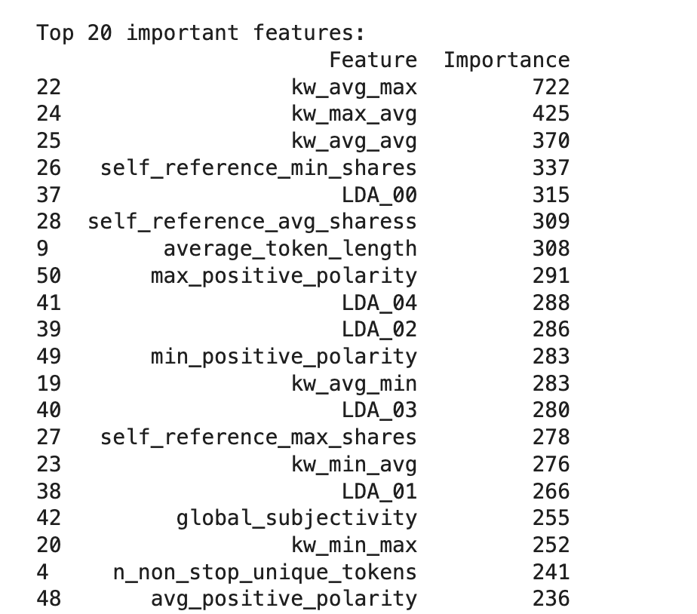
Modeling & Evaluation
Significant type of features:
Keywords
Number of Shares of the Referenced Articles in Mashable
LDA Types: Unknown types generated by LDA topic modeling, a unsupervised learning model (Fernandes and Kelwin 2015)
Polarity: a score generated by sentiment analysis method from NLP
Notes:
kw_avg_max: the average shares of best-performing keywords.

Slide 24
Modeling & Evaluation
Comparison of Models on Different Classes
 | High | Low | Medium | Viral
Logistic Regression | 30.20% | 56.50% | 45.50% | 18.00%
Random Forest | 25.70% | 59.60% | 43.20% | 17.40%
Gradient Boosting | 26.00% | 59.70% | 45.60% | 16.70%
XGBoost | 30.10% | 59.70% | 45.50% | 17.60%
LightGBM | 32.80% | 59.00% | 46.50% | 20.00%

Slide 25
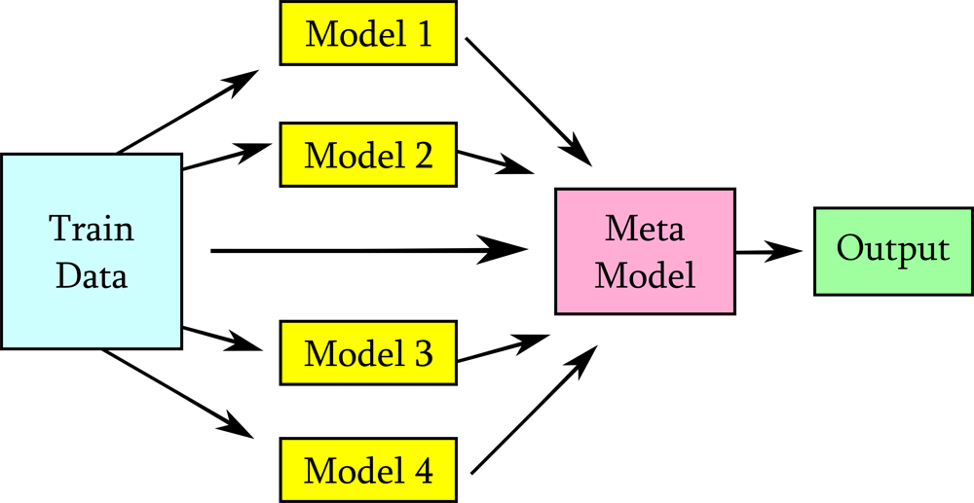
Modeling & Evaluation
Stacking
https://www.perplexity.ai/page/what-is-stacking-in-machine-le-hpx56HOJQXaYqEC3Q.3N5w
Notes:
Meta Model accept the predictions of level-0 models and fit model using predictions.

Slide 26
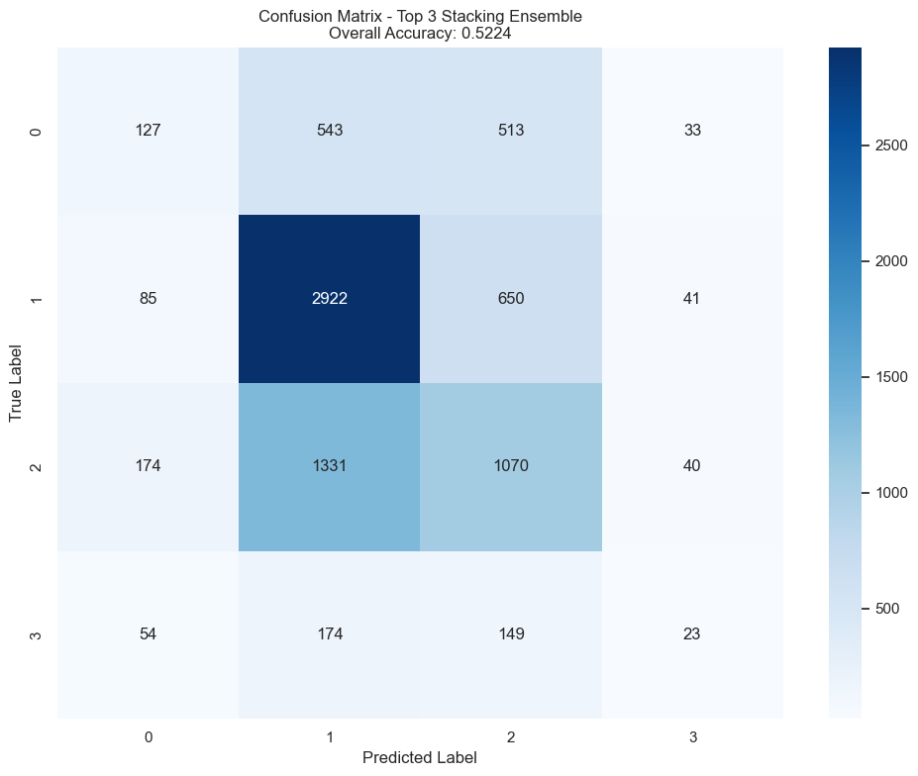
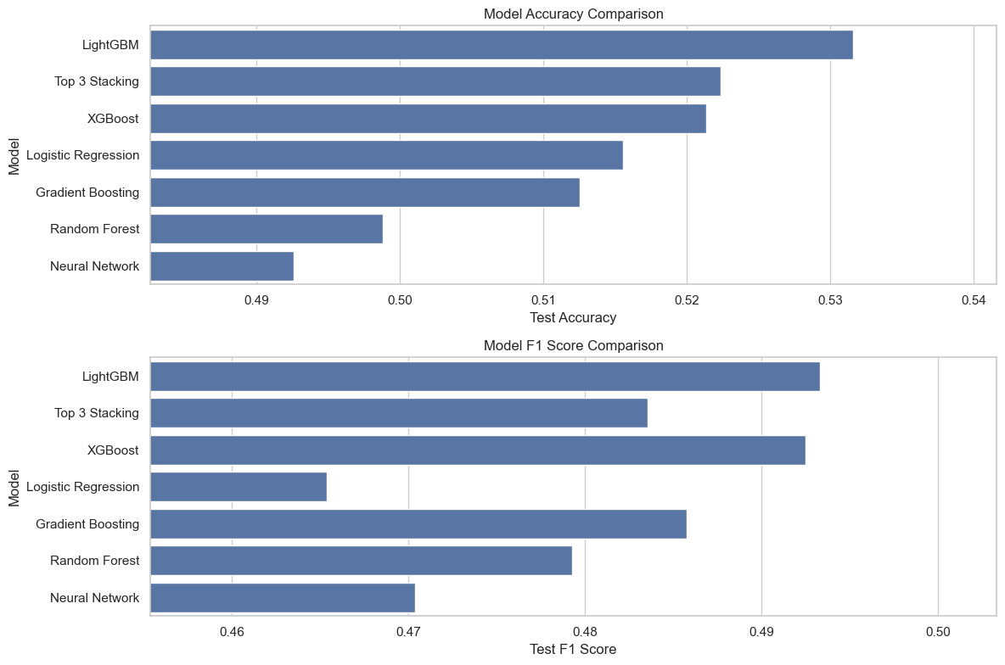
Modeling & Evaluation
Our Stacking Model: Combination of LR, XGBoost and LightGBM

Slide 27
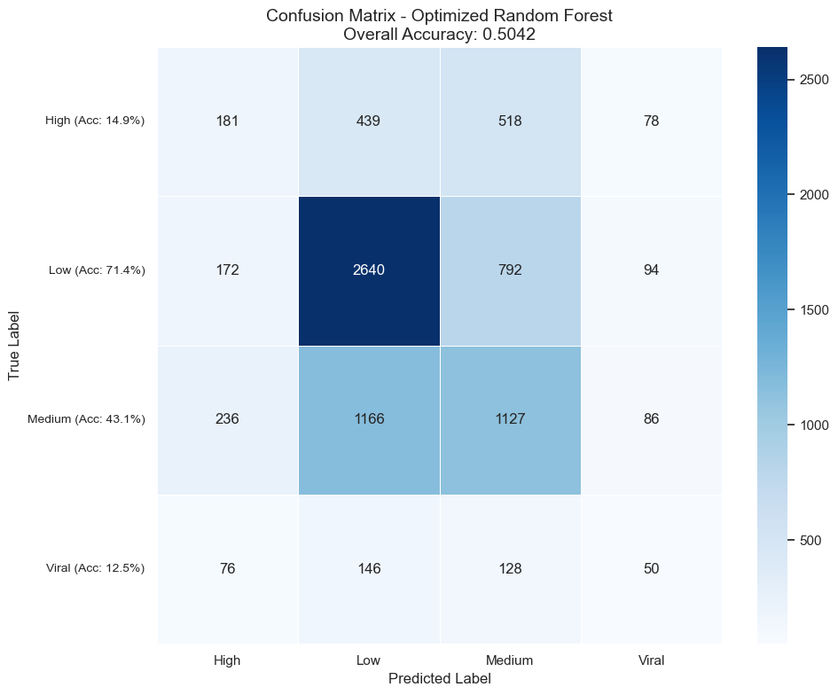
Optimization
Random Forest Model Performance Summary
Hyperparameter Tuning: Best parameter found: n_estimators = 500
Performance Metrics:
Cross-validation accuracy: 0.5266
Test accuracy: 0.5042
Test F1-score: 0.4846
Confusion Matrix Insights:
Best performance: Low class (71.4% accuracy)
Poor performance: High (14.9%) and Viral (12.5%) classes
Model is biased toward predicting Low class
Classification Report:
High: Precision 24.9%, Recall 14.9%, F1-score 19.2%
Low: Precision 60.1%, Recall 71.4%, F1-score 65.3%
Medium: Precision 43.9%, Recall 43.1%, F1-score 43.5%
Viral: Precision 16.2%, Recall 12.5%, F1-score 14.2%
Notes:
The overall accuracy of the optimized model showed almost no improvement (50.44% → 50.42%), mainly due to limitations in data and model performance. The dataset itself has low predictability, making it difficult for the model to extract effective patterns even with hyperparameter tuning. Additionally, the Random Forest model may have reached its performance ceiling, meaning further tuning does not lead to significant improvements.
Moreover, PCA resulted in a noticeable performance decline, indicating that the dataset's key information is distributed across multiple feature dimensions, and PCA might have removed important information. This suggests that PCA is not suitable for this dataset, and future optimizations should focus more on feature engineering and data augmentation rather than relying solely on model tuning or dimensionality reduction.
Additionally, from the confusion matrix, the model performs best in the Low category (71.4%) but struggles significantly in High (14.9%) and Viral (12.5%) categories, demonstrating a clear imbalance in predictions and a bias toward low-engagement news. The classification report further highlights that Precision and Recall for High and Viral categories are low, indicating that the model fails to distinguish highly interactive news, resulting in poor F1-scores.
Overall, the model’s performance is limited by data characteristics and class distribution, making it difficult to improve solely through hyperparameter tuning.

Slide 28

Optimization
XGBoost Model Performance Summary
Hyperparameter Tuning:
Best parameters:
subsample = 0.7, reg_lambda = 1, reg_alpha = 0.2
n_estimators = 400, min_child_weight = 9, max_depth = 6
learning_rate = 0.03, gamma = 0.3, colsample_bytree = 0.7
Performance Metrics:
Cross-validation accuracy: 0.5606
Test accuracy: 0.5282
Test F1-score: 0.4935
Confusion Matrix Insights:
Best performance: Low class (78% accuracy)
Poor performance: High (10.1%) and Viral (9.0%) classes
Model still favors Low class, but overall accuracy has improved
Classification Report:
High: Precision 29.6%, Recall 10.1%, F1-score 15.1%
Low: Precision 59.6%, Recall 78.0%, F1-score 67.6%
Medium: Precision 46.4%, Recall 43.8%, F1-score 45.1%
Viral: Precision 17.3%, Recall 9.0%, F1-score 11.8%
Notes:
1. The model showed slight improvement after optimization, but the impact is minimal
After optimization, the test accuracy increased from 52.14% to 52.82%, showing slight improvement, but the gain is insignificant. The cross-validation accuracy is 56.06%, which is higher than the test accuracy, suggesting a slight overfitting issue. The F1-score only improved from approximately 49.3% to 49.35%, indicating that parameter tuning had a limited effect on overall model performance.
2. Class prediction bias remains
From the confusion matrix, the model performs best in the Low category (78.0% accuracy), but it still favors predicting low-engagement news. The accuracy for High (10.1%) and Viral (9.0%) categories remains low, indicating that the model struggles to identify highly engaging news. The classification report further shows that the Precision and Recall for High and Viral categories remain low, with the F1-score for the Viral class as low as 11.8%, highlighting the model's poor performance in this category.
3. PCA reduced model performance, indicating that the dataset is not suitable for PCA
After applying PCA, the model’s performance decreased significantly, suggesting that the dataset's key information is distributed across multiple feature dimensions. PCA likely removed important features, leading to worse classification results. This confirms that PCA is not suitable for this dataset, and alternative feature selection techniques should be explored instead.
Conclusion
Although the XGBoost model showed slight improvement after optimization, the impact is minimal. Furthermore, PCA led to a performance decline, indicating that this dataset is not well-suited for dimensionality reduction techniques.

Slide 29
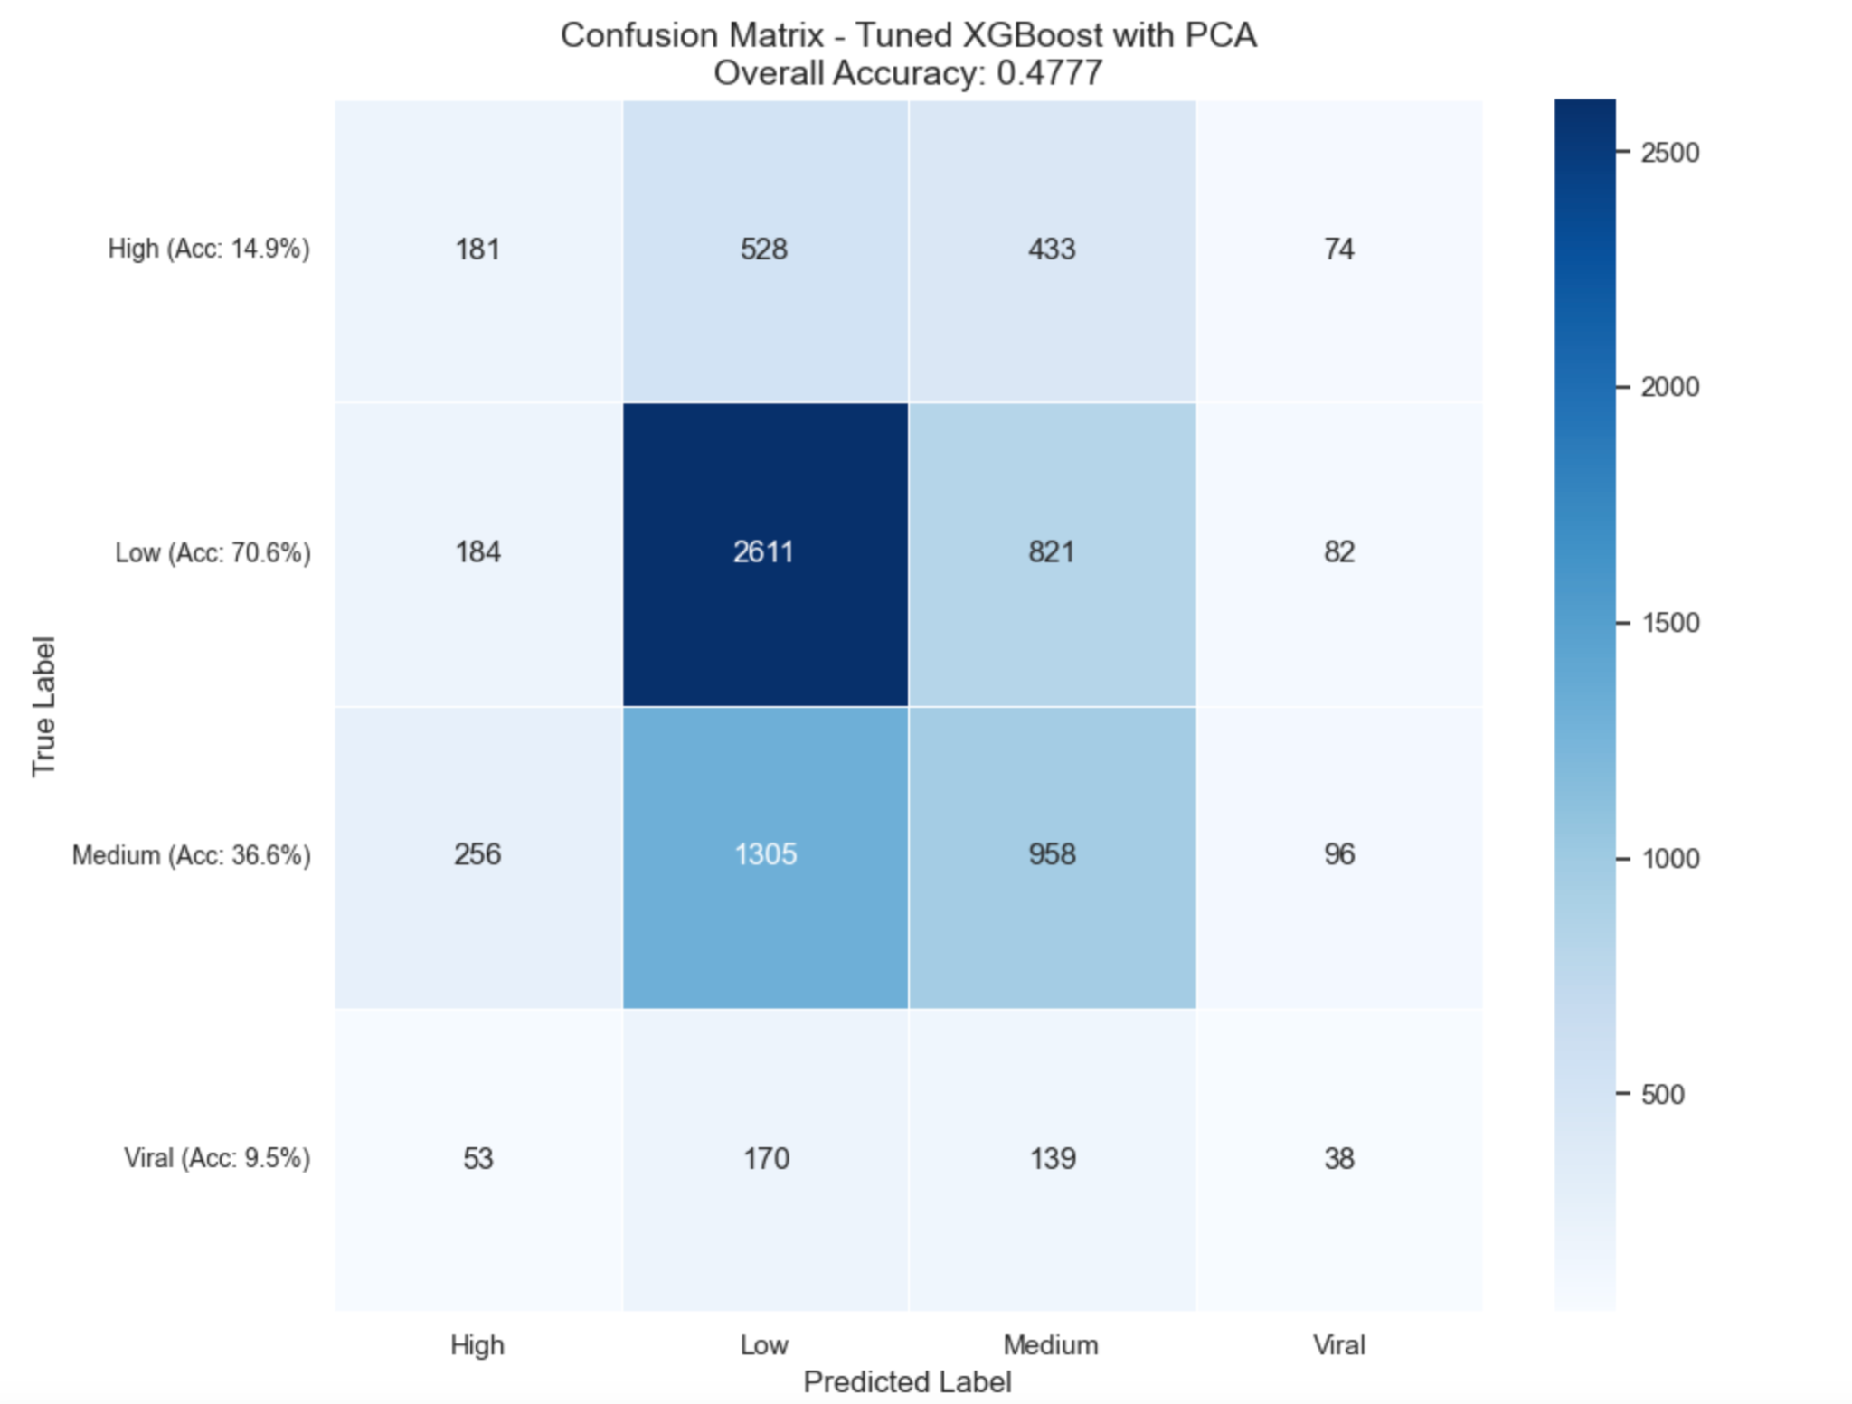
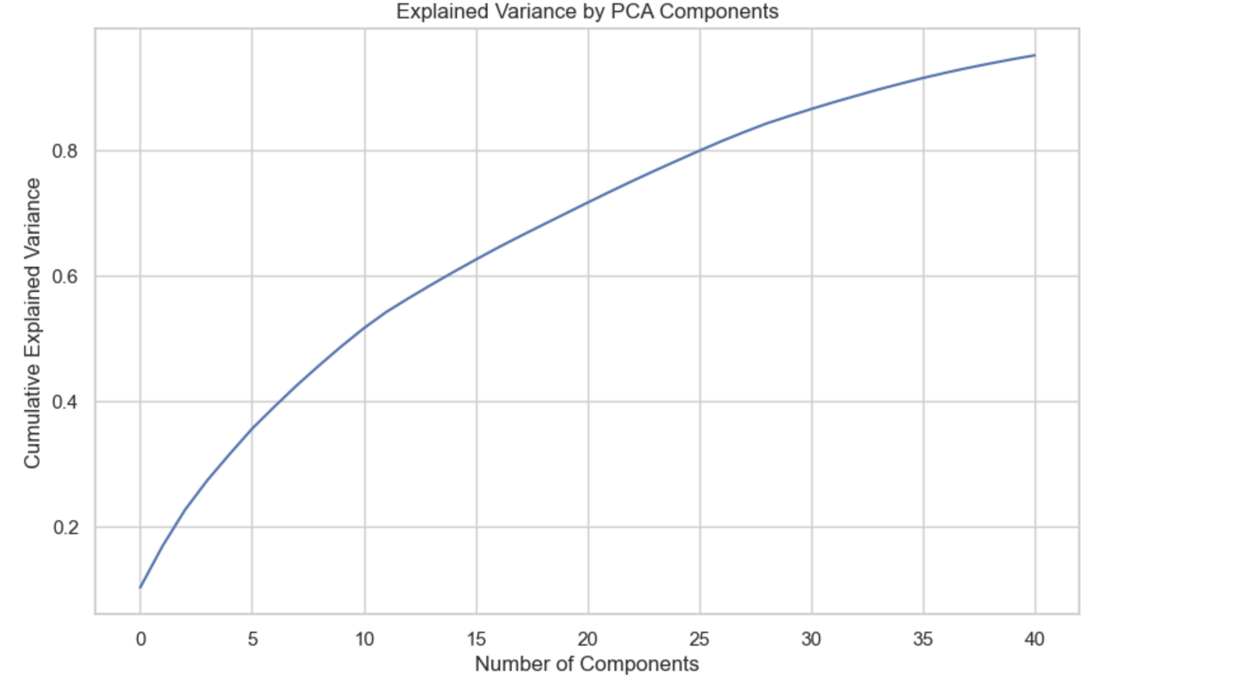
Optimization
XGBoost with PCA Performance Summary
Hyperparameter Tuning:
Best parameters:
subsample = 0.9, reg_lambda = 10, reg_alpha = 1.0
n_estimators = 300, min_child_weight = 5, max_depth = 6
Principal Component Analysis (PCA):
41 components selected based on explained variance.
PCA helps reduce dimensionality while retaining most variance.
Performance Metrics:
Cross-validation accuracy: 0.5260
Test accuracy: 0.4777
Test F1-score: 0.4552
Confusion Matrix Insights:
Best performance: Low class (70.6% accuracy)
Poor performance: High (14.9%) and Viral (9.5%) classes
Model's ability to predict Medium class has slightly decreased.
Classification Report:
High: Precision 26.9%, Recall 14.9%, F1-score 19.2%
Low: Precision 56.6%, Recall 70.6%, F1-score 62.8%
Medium: Precision 40.7%, Recall 36.6%, F1-score 38.6%
Viral: Precision 13.1%, Recall 9.5%, F1-score 11.0%
Comparison with Previous XGBoost Model:
Slight accuracy drop (47.77% → 49.63%)
Lower recall for Medium & Viral classes → PCA may have removed key features
Feature reduction trade-off → Impacts classification quality
Recommendations:
Adjust PCA component selection to retain more information
Use feature selection instead of PCA for key features
Tune learning rate & boosting method for better performance
Notes:
Hyperparameter tuning identified best parameters: subsample = 0.9, reg_lambda = 10, reg_alpha = 1.0, n_estimators = 300, min_child_weight = 5, max_depth = 6. These parameters differ from the original XGBoost model, showing adjustments for post-PCA configuration.
Principal Component Analysis (PCA) selected 41 components based on explained variance. PCA helps reduce dimensionality while retaining most variance. This dimensional reduction approach may impact feature interpretability.
Performance metrics show cross-validation accuracy of 0.5260, test accuracy of 0.4777, and F1-score of 0.4552. Compared to the previous XGBoost model, there's a slight accuracy drop (47.77% vs 49.63%).
Confusion matrix insights reveal best performance on the Low class (70.6% accuracy) and poor performance on High (14.9%) and Viral (9.5%) classes. The model's ability to predict the Medium class has slightly decreased, suggesting PCA may have removed key features for Medium class differentiation.
Compared with the previous XGBoost model, using PCA resulted in a slight accuracy drop and lower recall for Medium and Viral classes. This suggests the feature reduction trade-off negatively impacts classification quality.
Recommendations include adjusting PCA component selection to retain more information, using feature selection instead of PCA for key features, and tuning learning rate and boosting methods for better performance.

Slide 30
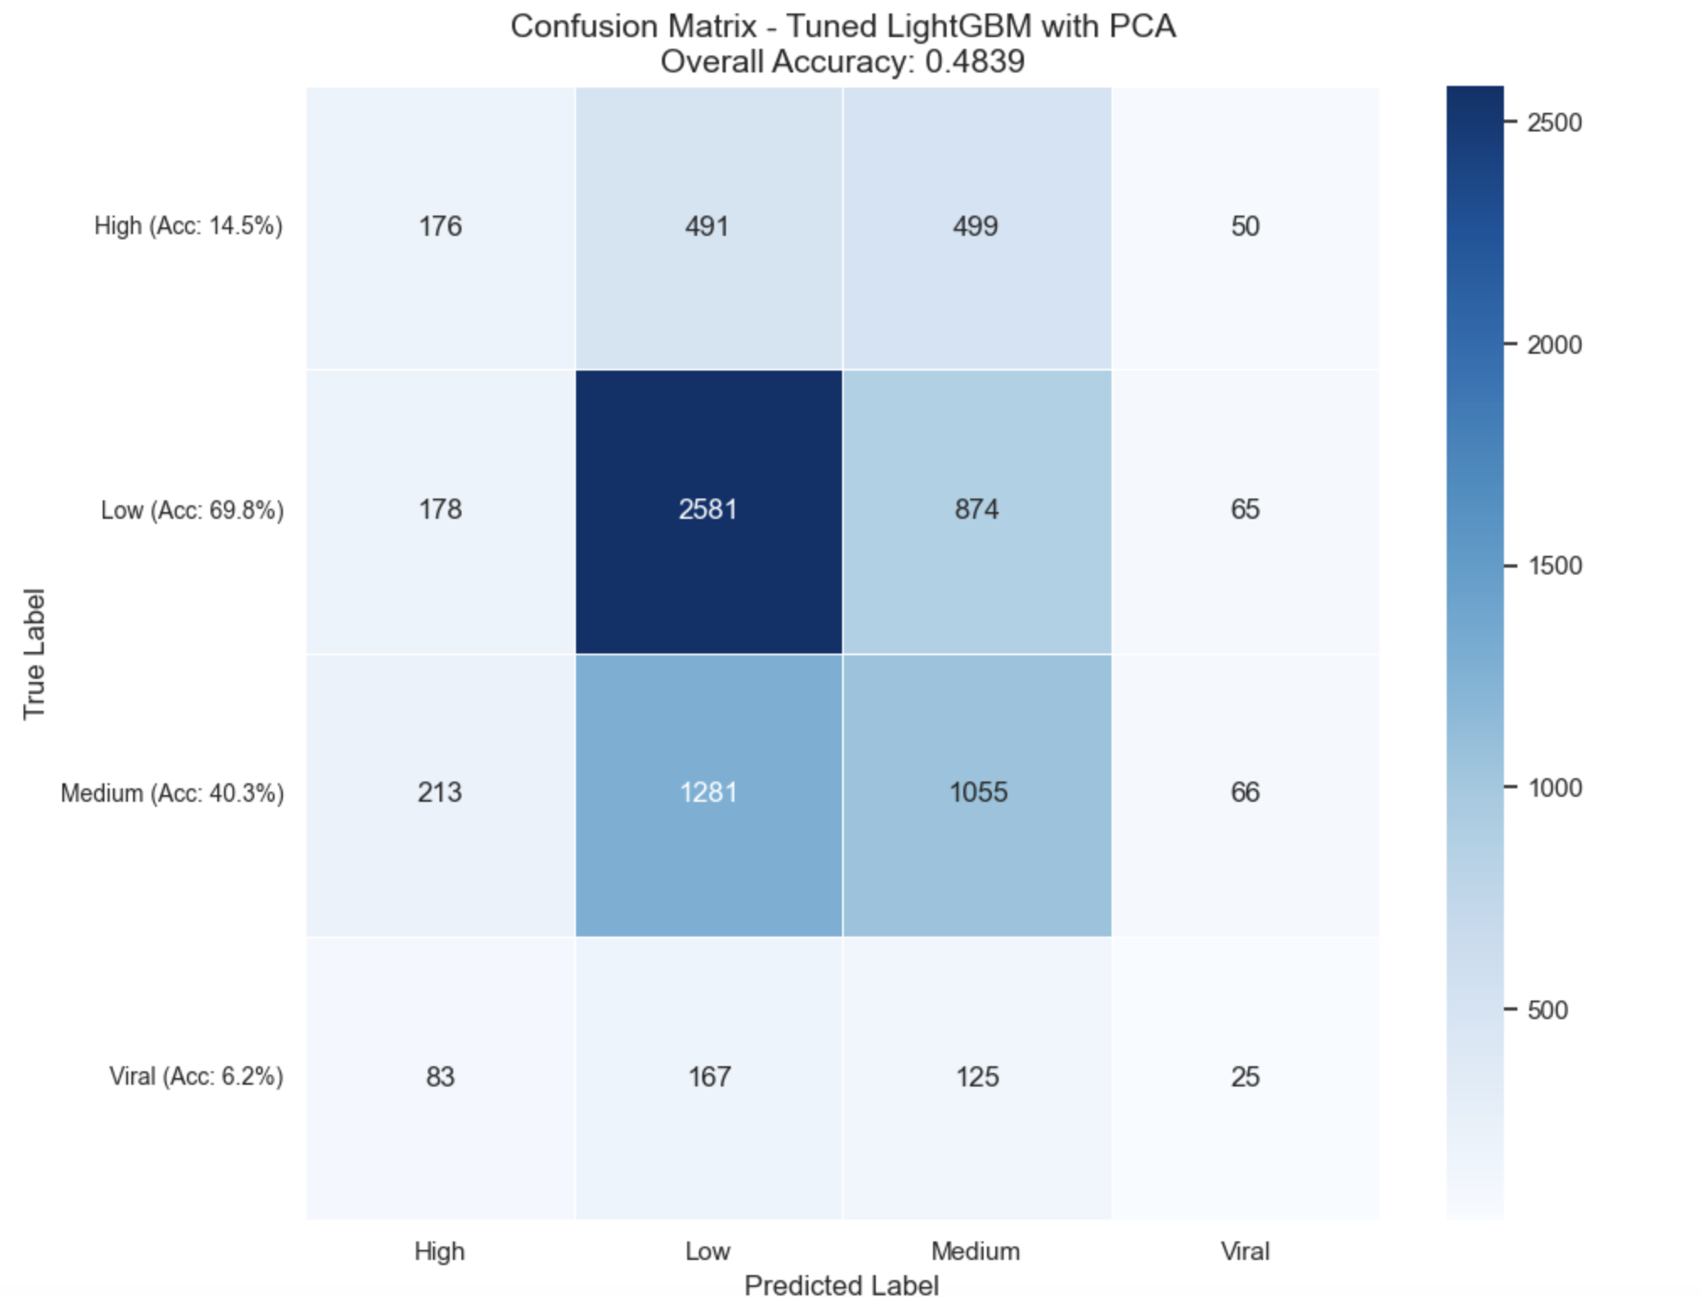
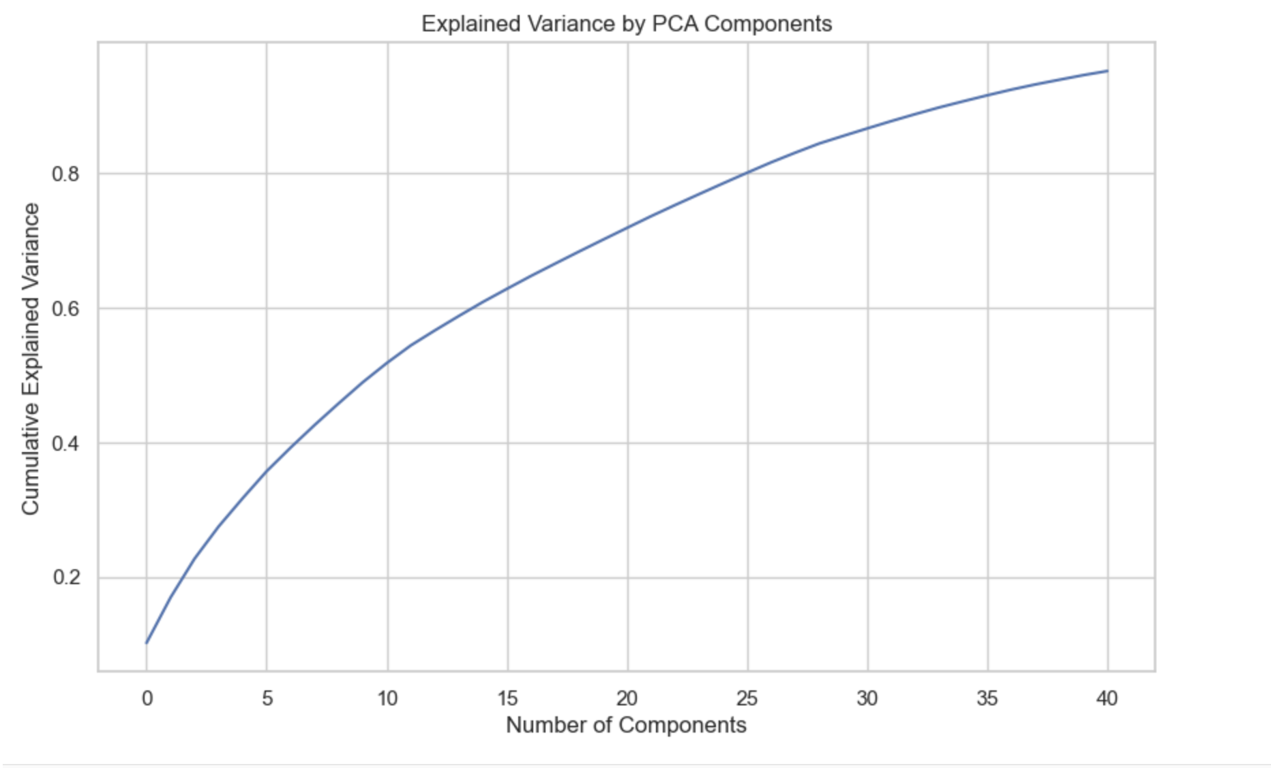
Optimization
Comparison with XGBoost PCA:
Similar accuracy (48.39% vs. 47.77%)
Higher recall for Low class, worse for Viral
PCA (41 components) may still remove key info
LightGBM with PCA Performance Summary
Best Parameters:
subsample = 0.9, reg_lambda = 0.1, reg_alpha = 0.1
num_leaves = 31, n_estimators = 300, min_child_samples = 20
Performance:
CV accuracy: 0.5233
Test accuracy: 0.4839
Test F1-score: 0.4607
Confusion Matrix Insights:
Best: Low class (69.8%)
Weak: High (14.5%) & Viral (6.2%)
Model leans toward predicting Low & Medium
Classification Report:
High: Precision 27.1%, Recall 14.5%, F1 18.9%
Low: Precision 57.1%, Recall 69.8%, F1 62.8%
Medium: Precision 41.3%, Recall 40.3%, F1 40.8%
Viral: Precision 12.1%, Recall 6.2%, F1 8.3%
Notes:
Best Parameters:
subsample = 0.9, reg_lambda = 0.1, reg_alpha = 0.1
num_leaves = 31, n_estimators = 300, min_child_samples = 20
Performance:
CV accuracy: 0.5233
Test accuracy: 0.4839
Test F1-score: 0.4607
Confusion Matrix Insights:
Best: Low class (69.8%)
Weak: High (14.5%) & Viral (6.2%)
Model leans toward predicting Low & Medium
Classification Report:
High: Precision 27.1%, Recall 14.5%, F1 18.9%
Low: Precision 57.1%, Recall 69.8%, F1 62.8%
Medium: Precision 41.3%, Recall 40.3%, F1 40.8%
Viral: Precision 12.1%, Recall 6.2%, F1 8.3%
Comparison with XGBoost PCA:
Similar accuracy (48.39% vs. 47.77%)
Higher recall for Low class, worse for Viral
PCA (41 components) may still remove key info
Recommendations:
Try feature selection over PCA
Increase model complexity (e.g., more leaves)
Tweak boosting parameters for better balance

Slide 31
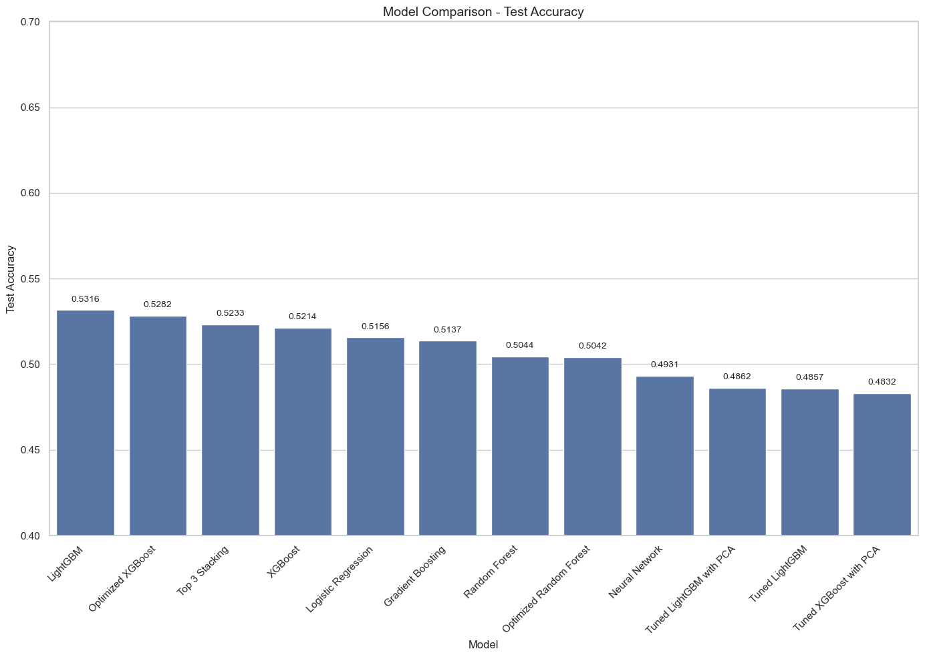
Optimization
Notes:
Best Model: LightGBM
Test Accuracy: 0.5316
Performance Insights
LightGBM achieves the highest test accuracy, but only by a small margin.
Top Stacking and XGBoost follow closely, with minimal accuracy differences.
Logistic Regression and Gradient Boosting perform competitively.
Random Forest, Tuned XGBoost, and Neural Networks have lower accuracy.
PCA-based models (Tuned XGBoost with PCA, Tuned LightGBM with PCA) fail to show improvement, indicating PCA may not help in this case.
Random Forest had decent performance, but tuning did not enhance generalization, suggesting potential overfitting.
Key Observations
Hyperparameter tuning had limited impact—tuned models did not outperform their default counterparts significantly.
Dataset may lack strong predictive features, making it difficult to boost performance through tuning alone.
Machine learning models struggle with this prediction task, indicating that online news popularity may be inherently challenging to predict.

Slide 32
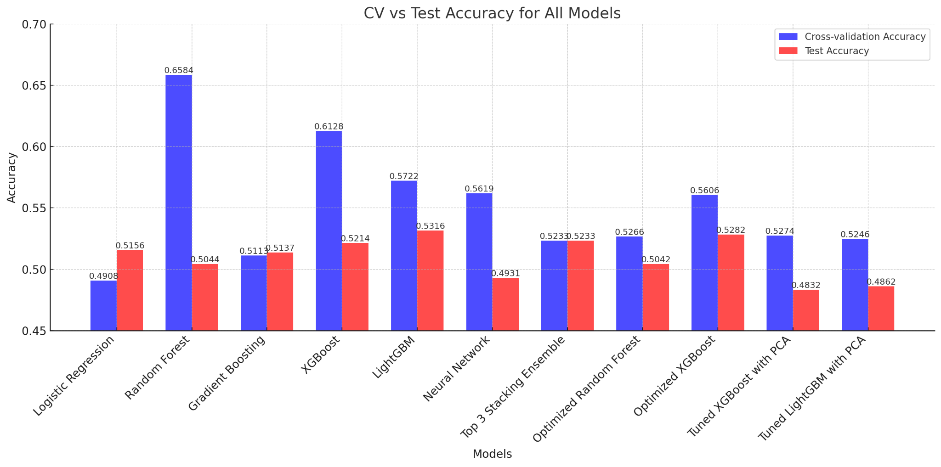
Optimization
Notes:
In this experiment, we tested multiple models and examined both their cross-validation (CV) accuracy and test accuracy. Overall, LightGBM performed the best, achieving the highest test accuracy among all models.
However, we observed that Random Forest and XGBoost had relatively high cross-validation accuracy, indicating strong learning capability during training. Based on this, we fine-tuned both models to improve their performance.
After optimization, Random Forest’s test accuracy actually decreased, suggesting a potential overfitting issue. XGBoost’s test accuracy slightly improved (from 52.14% to 52.82%), but it still did not outperform LightGBM, meaning the tuning had a limited impact.
Additionally, we attempted a Stacking Ensemble model, hoping that combining multiple models would enhance performance. However, the final test accuracy was still lower than LightGBM. This indicates that, for this dataset, LightGBM remains the best-performing model, and neither hyperparameter tuning nor model stacking could surpass its results.

Slide 33
For the original dataset, we have tried various treatments, but the final model is still limited.
The author and his number of followers do not directly reflect the quality of the article(Maybe it's caused by time.)
For the original dataset, we have tried various treatments, but the final model is still limited.
We need more and more information that is directly related to the quality of the article

Slide 34
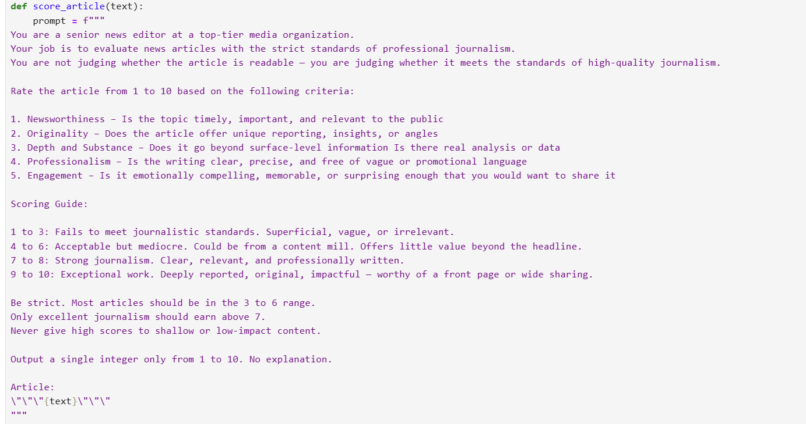
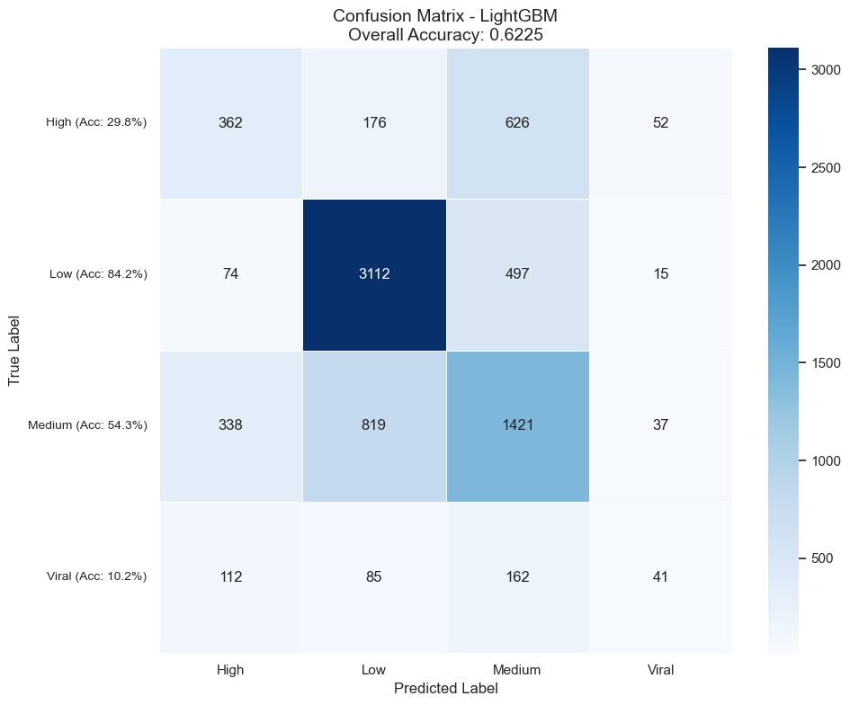
A New Attempt - Using AGI to Introduce Article Quality Scores
Confusion Matrix Insights (LightGBM)
Accurate in Normal Ranges
The model performs improve on Low (84.2%), High (29.8%), and Medium (54.3%)
Weak on Viral Prediction
The model performs still poorly on Viral articles (10.2%).
Scoring Prompt Highlights:
Newsworthiness
Originality
Depth & substance
Journalistic professionalism
Emotional engagement & shareability
1
2
3
4
Crawling article content
Calling the Deepseek API for scoring
Save data
Prediction and Evaluation
Use newspaper3k to extract full article content from each URL.
Economical price and convenient API
Saving a new CSV File
Accuracy was over 62%, a 10% improvement over the original model

Slide 35
Conclusion & Future Work
Conclusion: Challenges in Predicting News Popularity
Key Findings:
Keyword relevance & quantity impact engagement.
Subjectivity & emotional tone influence shareability.
Machine learning models achieved max 53% accuracy despite tuning.
Challenges:
High class imbalance → Used SMOTE, but risk of overfitting.
External factors (trends, social media dynamics) make prediction difficult.
Future Improvements:
Integrate real-time social media data for better prediction.
Leverage user engagement metrics to refine models.
Notes:
Machine learning struggles to predict news popularity, achieving a maximum accuracy of only 53%. Keyword relevance and quantity affect engagement, while subjectivity and emotional tone influence shareability. Class imbalance required SMOTE but introduced overfitting risks. External factors like trends and social media dynamics further complicate predictions. Future improvements should incorporate real-time social media data and leverage user engagement metrics to enhance model performance.

Slide 36
Reference:
Domingos, Pedro. 2012. A Few Useful Things to Know About Machine Learning. Communications of the ACM 55(10): 78-87.
Breiman, Leo. 2001. Random Forests. Machine Learning 45(1): 5-32.
Chen, Tianqi, and Carlos Guestrin. 2016. XGBoost: A Scalable Tree Boosting System. In Proceedings of the 22nd ACM SIGKDD International Conference on Knowledge Discovery and Data Mining, 785-794.
Fernandes, Kelwin. (2015). A Proactive Intelligent Decision Support System for Predicting the Popularity of Online News.
Ke, Guolin, et al. 2017. LightGBM: A Highly Efficient Gradient Boosting Decision Tree. In Proceedings of the 31st Conference on Neural Information Processing Systems (NeurIPS), 3146-3154.
UCI Machine Learning Repository. 2015. Online News Popularity Data Set. Accessed March 10, 2025. https://archive.ics.uci.edu/dataset/332/online+news+popularity.

Slide 37
Q&A

Slide 38
Thank you!

